Slide 1


Slide 2
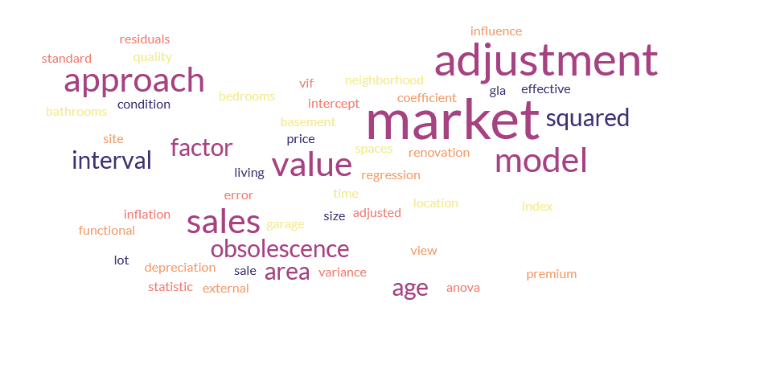
What is MRA

Slide 3


Specification, Log Transformation, Robust Standard Errors, Weighted Least Squares, OLS, Diagnostics, Residual Plot, Scatterplot Matrix, Correlation Matrix, Covariance, Autocorrelation, Collinearity Diagnostics, Ordinary Least Squares (OLS)
Normality Test, Durbin–Watson, Outliers, Influential Points, Leverage, Model Fit, Confidence Interval, Prediction Interval, Standardized Residuals, T Statistic, Degrees of Freedom, Error Term, Model
Regression, Coefficient, Intercept, Residuals, Standard Error, R Squared, Adjusted R Squared, P Value, F Statistic, ANOVA, Variance Inflation Factor, VIF, Multicollinearity, Heteroskedasticity

Slide 4
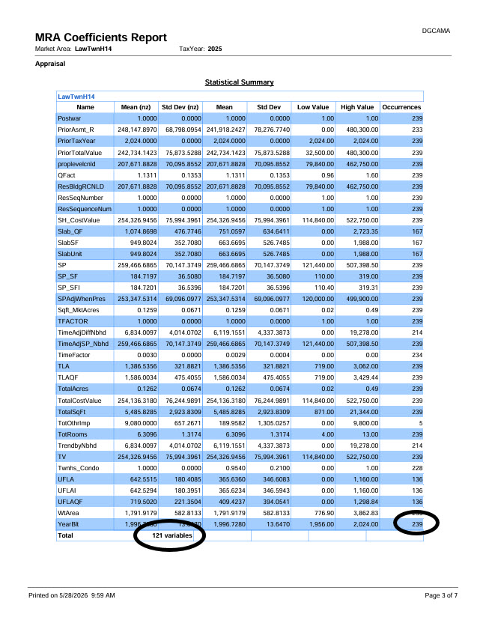
  Statistical Summary
  Provides user with a list of market modeling variables which have at least one occurrence in the current population of sales available for modeling. Note: Sales which have been flagged as “D” or “C” will not show as an occurrence.
  Total = Total number of variables with an observation.
  Occurrences = Total number of observations in the sales population for each variable.

Slide 5
Foreign Terms | Math Speak
Mean (NZ) | Average with divisor not counting NULLS or 0
Std Dev (NZ) | Pure distribution
Low and High Values | Based on Edit and Expansion Results not raw data

Slide 6
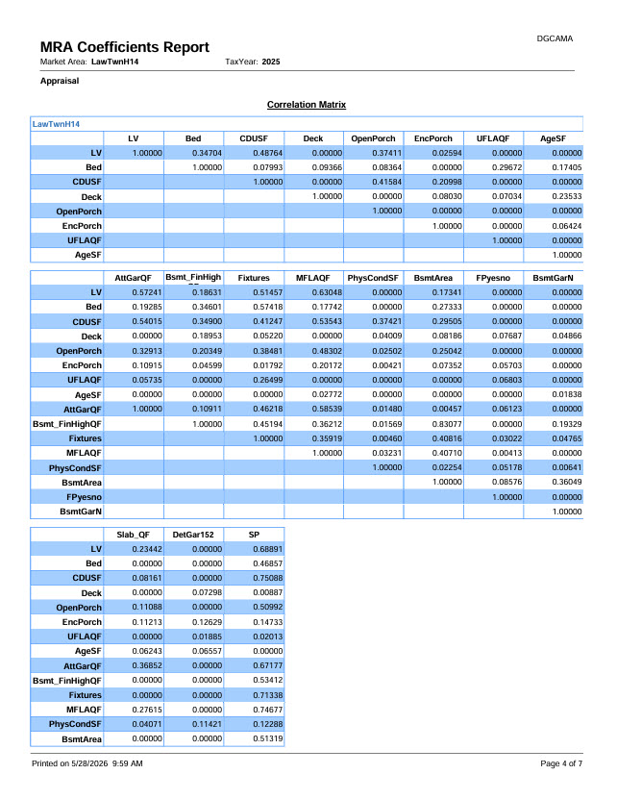
  Correlation Matrix
  Correlation matrix – is a matrix showing the pairwise correlation between all variables in the model (including the dependent variable). Variables highly correlated with sale price are the most important. Values closer to 1.00 indicate higher correlation.
    High correlation between independent variables is less optimal
    High correlation between independent variables and dependent variable is good

Slide 7
Correlation measures the linear association between two variables; partial correlation measures the linear association between two variables after removing the linear effects of one or more control variables. Use correlation to see raw pairwise relationships and partial correlation to see the relationship that remains once confounders are held constant.
(Pearson’s 𝑟 ) is a single number between 1 and 1 that quantifies the strength and direction of a linear relationship between two variables.
𝑟=1 means a perfect positive linear relationship,
𝑟= −1 a perfect negative one,
and
𝑟=0 Indicates no linear relationship.
Correlation does not control for other variables and can be misleading when a third variable influences both variables of interest.

Slide 8
Partial correlation
Partial correlation measures the linear association between two independent predictor variables while controlling for the effects of the other independent variables.
This is known as the crime of multicollinearity

Slide 9
The Crime of Multicollinearity
Small changes in the data or which variables are included can produce large swings in estimated coefficients.
When predictors are collinear, standard errors grow, so t‑tests lose power and true effects may appear non‑significant.
Coefficients may have counterintuitive signs or magnitudes because the model is partitioning shared variation arbitrarily.
Often triggered by including the same predictor in different forms.

Slide 10
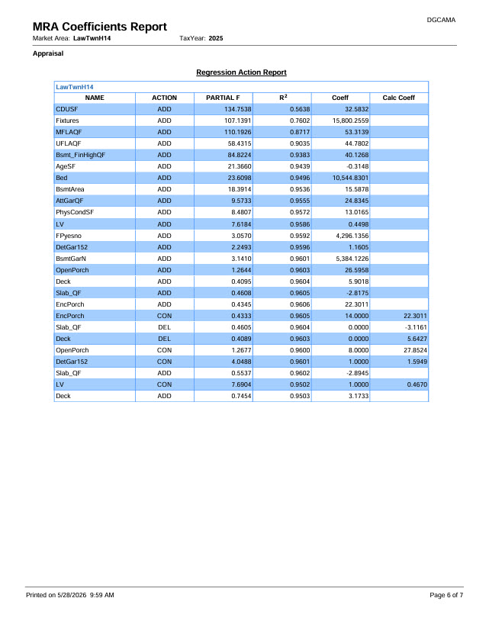
  Regression Action Report
  Shows the work of the model as it adds and removes variables during the constrained, stepwise regression process.
  Stepwise Regression Routine - Enters variables in order of their contribution to reducing the Standard Error of the Estimate.
  Calc Coeff – Regression calculated coefficient value for that variable at the time it was constrained or at the time it left the action.

Slide 11
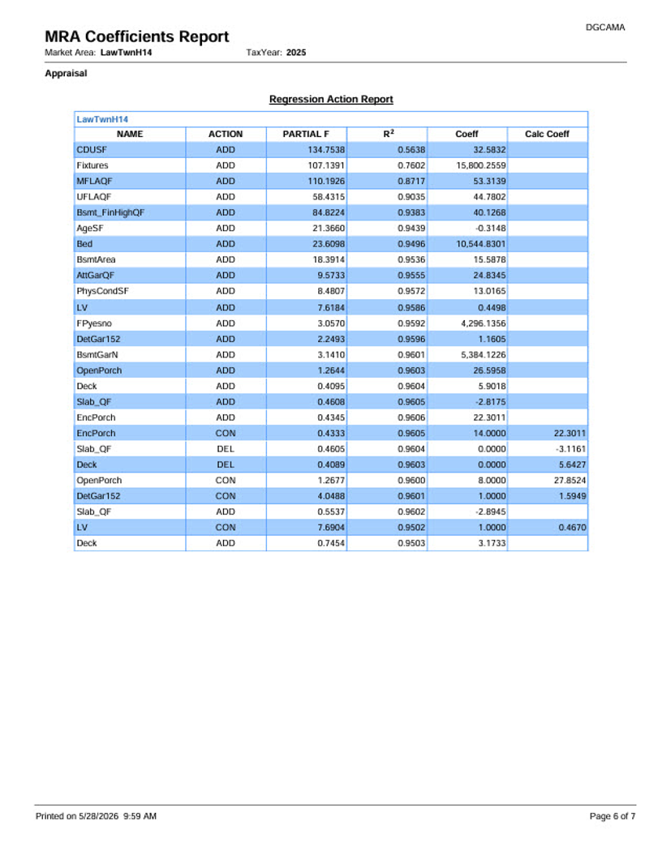
  Stepwise Regression With Removal
Forward starting with the strongest fit
Adds next strongest fit
Once the R squared stops increasing variables are removed one by one till R squared becomes stable.
Constrained variables have a Pseudo coefficient presented for comparison.

Slide 12
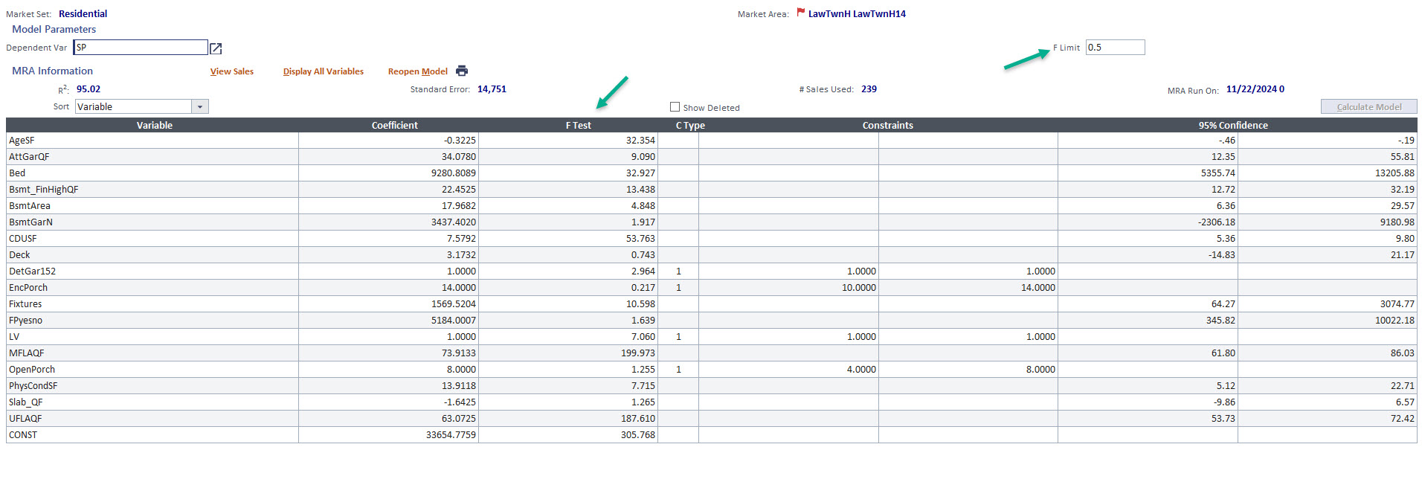
  F-Test
  A measure of variable importance. The higher the value, the more significant the variable.
  F-Value – is the T-value squared; F-Values above 4 are significant at the 95% confidence level.
  T-Value – is the ratio of a regression coefficient to its standard error (the higher the ratio, the more significant the variable.) T-values above 2 are significant at the 95% confidence level.
  F-Limit
  A minimum F-Value can be set to exclude variables which do not meet the threshold.
  When variables do not meet the F-Limit, they drop out of the regression action, unless they are constrained.
  Increasing the limit can help with simplicity and minimizing problems with collinearity. Alternatively, lowering the limit may allow for more variables to come in naturally without the need for constraints.

Slide 13
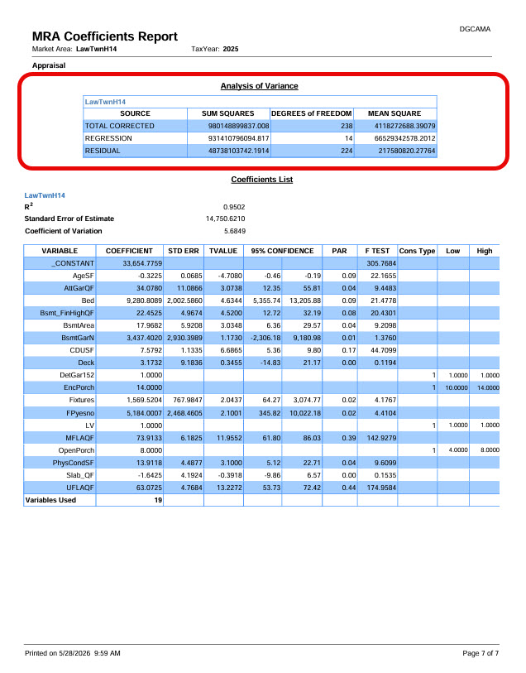

Slide 14
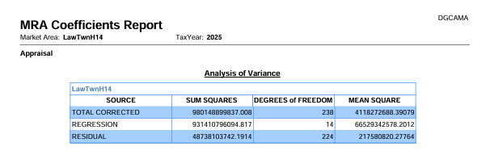
  Analysis of Variance Table
  Least Squares is the mathematical procedure used in the regression analysis to estimate the coefficients of a model.
  Its goal is simple. Find the equation that produces the smallest sum of all squared errors when predicting the observed data.

Slide 15
ANOVA FUNDAMENTALS
What Is ANOVA?
AT A GLANCE
📊
A Statistical Test
ANOVA checks if a regression model explains the data better than just guessing the average.
Compares model
vs. baseline
🔍
Comparing Variation
It splits the total variation in data into two parts: what the model explains vs. what it doesn't.
Splits variation
into two parts
🎯
The Big Question
Does our model actually do a better job than doing nothing at all?
Answers: is our
model useful?

Slide 16
How ANOVA Works — Step by Step
ANOVA breaks total data variation into parts — then checks which part is bigger.
1
2
3
4
TOTAL VARIATION
EXPLAINED
UNEXPLAINED
COMPARE!
Find the Total Variation
Find the Explained Variation
Find the Unexplained Variation
Compare the Two Parts
How spread out is all the data from the overall average (ȳ)?
SST captures this entire spread — no model needed yet.
If SSR >> SSE, the model explains far more than it misses — it's doing its job!
This ratio becomes the F-statistic.
How much of that spread does the regression line capture?
SSR = the part the model earns credit for.
How much variation is still left over after the regression line?
SSE = residuals, the model's leftover noise.
SSR
SSE
Good Model!
The relationship:
SST = SSR + SSE
Total
=
Explained
+
Unexplained
Steps 1–4 lead to the F-statistic on the next slides

Slide 17
Splitting the Variation
SST = SSR + SSE
SSR
SSE
SSR
SSE
Regression Sum of Squares
Error Sum of Squares
The regression line captures this variation
The leftover scatter around the regression line
The portion of total variation that our regression model successfully explains. It measures how far the predicted values (ŷ) deviate from the overall mean (ȳ).
A larger SSR means the model is doing more of the heavy lifting.
The portion of total variation our model could not explain. It measures how far the actual observed values (y) deviate from the predicted values (ŷ).
A smaller SSE means the model fits the data more tightly.
FORMULA
FORMULA
SSE = Σ (y − ŷ)²
SSR = Σ (ŷ − ȳ)²
actual value minus predicted value, squared & summed
predicted value minus the mean, squared & summed
SST
=
SSR
+
SSE
Total = Explained + Unexplained
SST = Σ (y − ȳ)² · Total Sum of Squares

Slide 18
ANOVA DEEP DIVE
The ANOVA Table
A summary table that organizes everything ANOVA calculates.
📋
Source
SS — Sum of Squares
🔢
df — Degrees of Freedom
Where does the variation come from? The table lists two sources: Regression (what the model explains) and Error (what it doesn't).
Measures the total amount of variation. Split into SSR (explained by the model) and SSE (the leftover error).
Counts how many values are free to vary. For Regression: df = 1 (for simple regression). For Error: df = n − 2.
SST = SSR + SSE
MS — Mean Square
F — The F-Statistic
p-value
Divides each Sum of Squares by its degrees of freedom. This averages out the variation so we can compare them fairly.
The main result of ANOVA. A big F means the model explains much more than the noise. A small F means it doesn't.
The probability of getting our F-statistic just by chance. If p < 0.05, we can trust that our model really works! ✅
MS = SS ÷ df
F = MSR ÷ MSE
SOURCE REGRESSION / ERROR
SS SSR & SSE
DF FREE VALUES
MS SS ÷ DF
F MSR ÷ MSE
P-VALUE < 0.05 = SIGNIFICANT

Slide 19
ANOVA DEEP DIVE
The ANOVA Table
A summary table that organizes everything ANOVA calculates.
📋
Source
SS — Sum of Squares
🔢
df — Degrees of Freedom
Where does the variation come from? The table lists two sources: Regression (what the model explains) and Error (what it doesn't).
Measures the total amount of variation. Split into SSR (explained by the model) and SSE (the leftover error).
Counts how many values are free to vary. For Regression: df = 1 (for simple regression). For Error: df = n − 2.
SST = SSR + SSE
MS — Mean Square
F — The F-Statistic
p-value
Divides each Sum of Squares by its degrees of freedom. This averages out the variation so we can compare them fairly.
The main result of ANOVA. A big F means the model explains much more than the noise. A small F means it doesn't.
The probability of getting our F-statistic just by chance. If p < 0.05, we can trust that our model really works! ✅
MS = SS ÷ df
F = MSR ÷ MSE
SOURCE REGRESSION / ERROR
SS SSR & SSE
DF FREE VALUES
MS SS ÷ DF
F MSR ÷ MSE
P-VALUE < 0.05 = SIGNIFICANT

Slide 20
ANOVA — SLIDE 7
The F-Test — Is Our Model Worth It?
THE FORMULA
F = MSR ÷ MSE — We divide what the model explains by what it cannot explain.
BIG F
THE F-VALUE SCALE
Big F = Good Model — A large F means the model explains way more than the noise.
≈1
5
10
20+
Small F
P < 0.05 THRESHOLD
Large F
SMALL F
Model FAILS
Model WORKS ✓
F near 1 = Bad Model — The model is no better than guessing the average.
F = MSR ÷ MSE
→ bigger is better
DECISION RULE
Check the p-value — If p < 0.05, we have strong evidence the model works.
The F-distribution determines whether your F-statistic is surprisingly large or just by chance.

Slide 21
WRAP-UP
Key Takeaways
01
ANOVA tests whether a regression model explains data better than just using the mean.
02
Total variation splits into: SSR (explained) + SSE (unexplained).
03
The F-statistic = MSR ÷ MSE — a bigger F means the model explains far more than the leftover noise.
04
A small p-value (< 0.05) means your model is statistically significant — not just luck.
05
Always check ANOVA assumptions: linearity, independence, normality, equal variance.
Understanding ANOVA = Understanding whether your model can be trusted.

Slide 22
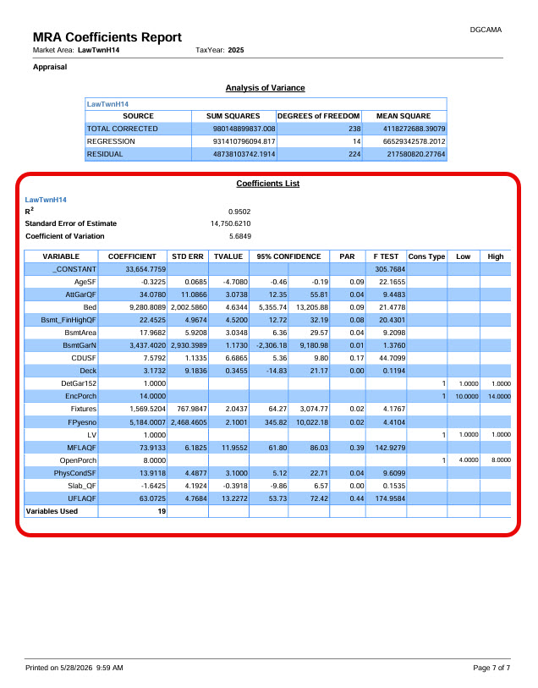

Slide 23
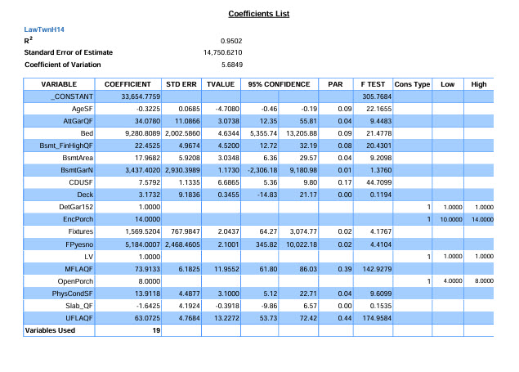
  Coefficients List
  Shows various statistical data outputs, including coefficient values for the current iteration of the regression model.
  Some of the data provides objective diagnostic statistical measures which allow appraisers to test the importance of variables within the model and to test how well a model fits the data.

Slide 24
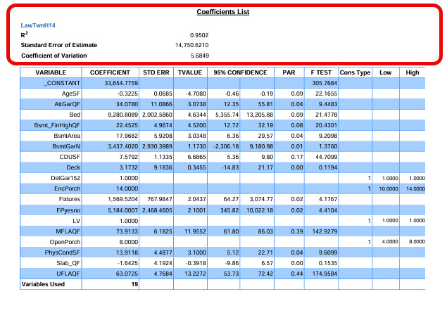
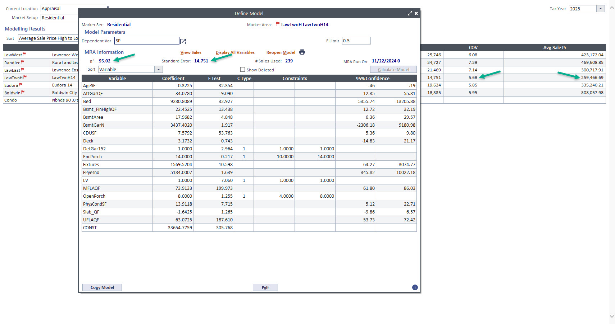
  Measures of Goodness of Fit
  R-Squared (Coefficient of Determination) – is percentage of variation in the dependent variable explained by the independent variables. As with all statistics, the R squared must be interpreted with caution, but in general, the higher the R squared, the more explanatory power the model has.
  Standard Error of the Estimate (Standard Error) – is the standard deviation of the regression errors. Roughly interpreted, represents the average difference between the predicted value and the actual sales price. The significance of the standard error must be considered in relation to the average sales price.
  Coefficient of Variation (COV) – is the standard error divided by the average of the dependent variable (sales price).

Slide 25
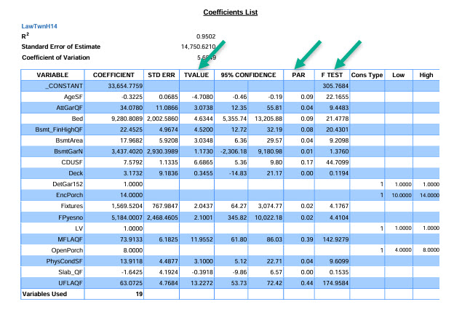
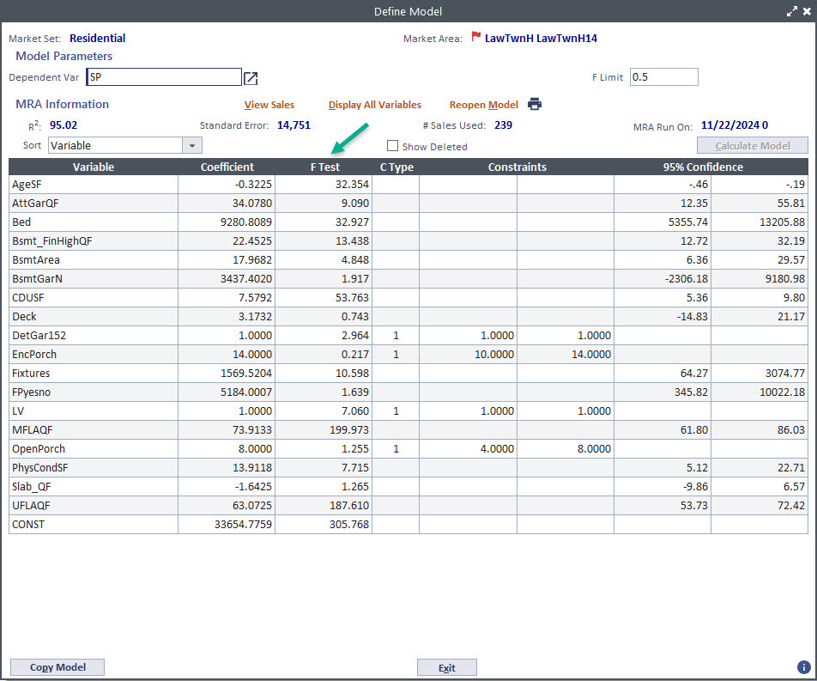
  Measures of Variable Importance
  Why does the F Test value on this report not match the F Test value on the model screen?
  What is PAR?

Slide 26
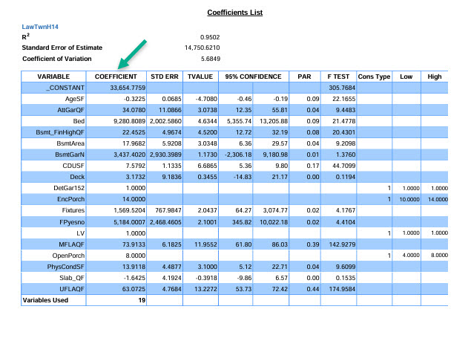
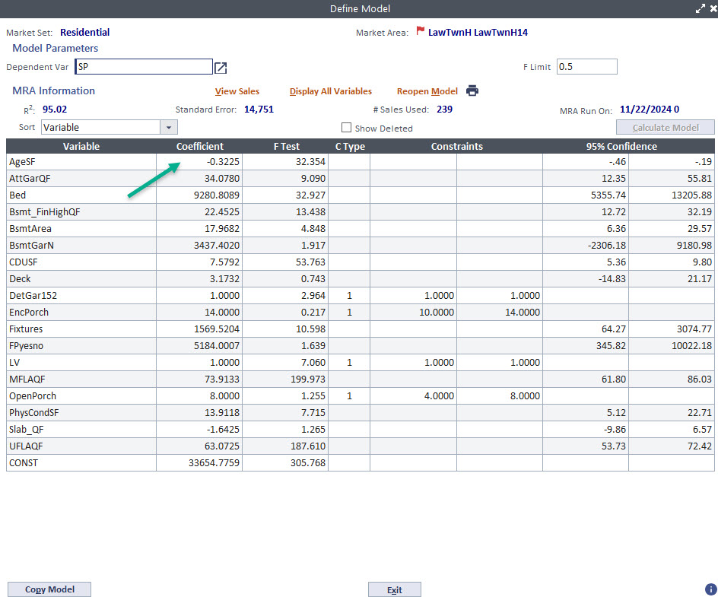
  Other Outputs
  Coefficient - In residential valuation, contributions (coefficients) are produced by measuring the relationships between independent variables (such as square feet of living area, bedroom counts, etc.) to the dependent variable (sale price). Independent variables integrate both quantitative and qualitative data, with descriptive attributes transformed into structured numerical sequences. The developed contributions (coefficients) serve as the monetary adjustments in the county’s sales comparison approach.

Slide 27
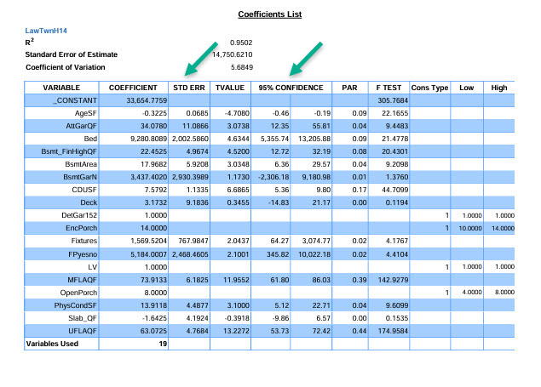
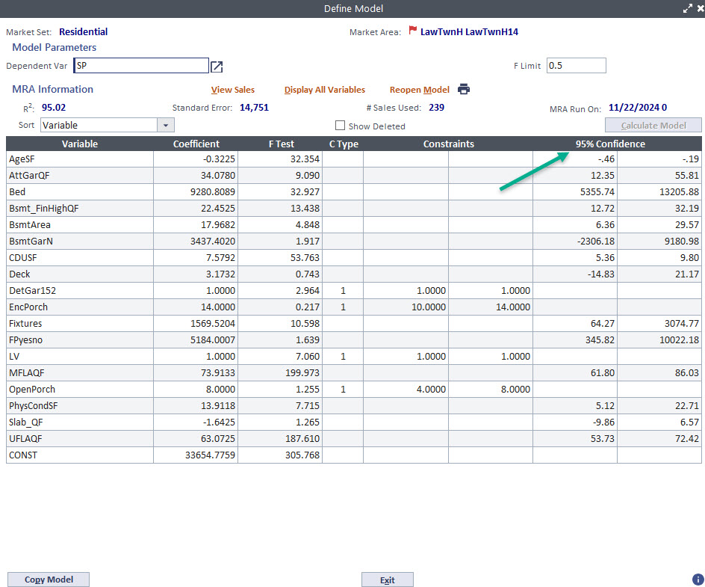
  Other Outputs
  STD ERR (Standard Error) – is the standard deviation of the regression error for the individual variable. The significance of the standard error must be considered in relation to the value of the coefficient.
  95% Confidence – 95th % confidence interval for the individual variable. Confidence intervals provide a range in which one can have a given degree of certainty that a true but unknown value lies within it. Confidence intervals provide a meaningful range of values where the true measure of central tendency is likely to fall.

Slide 28
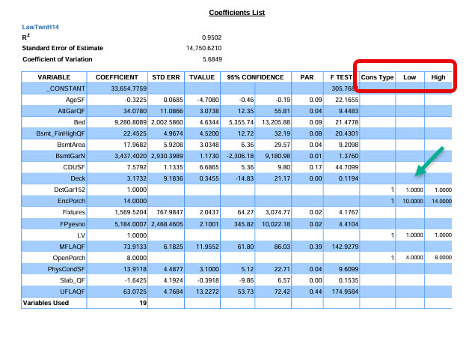
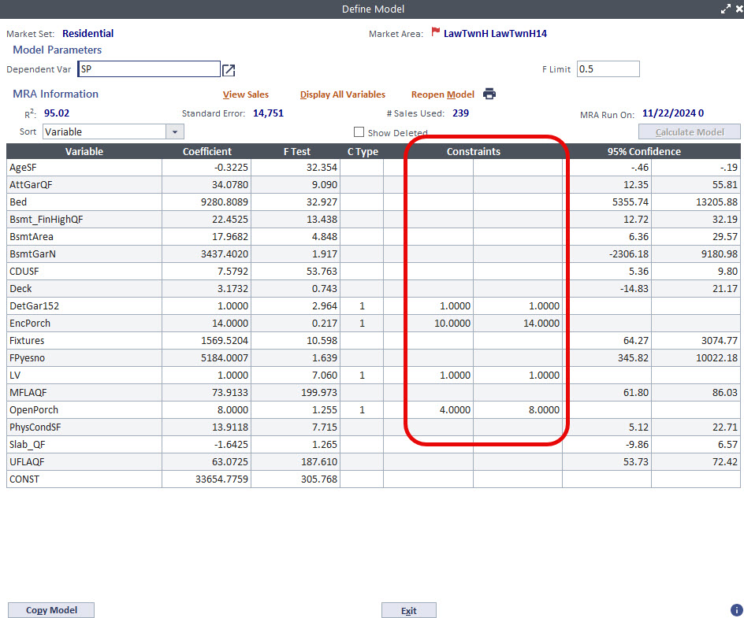
  Other Outputs
  Constrained Regression - is the process of constraining coefficients to lie with-in predefined bounds. It assists in producing explainable models. Whether the coefficients as calculated in the multiple regression run need to be constrained or brought within certain limits is a matter of appraisal, as well as statistical judgement.
  Constraints should be explainable and relative to the local housing market. An appraiser must consider the constraints effect on other variables and the overall fit of the model.
  Cons Type – Which constraint technique was utilized for the individual variable. For example: Apply the constraints and include the variable in the model.
  Low – Low range of constraint
  High – High range of constraint

Slide 29
  Why are certain variable always constrained one for one?
  Why do many see this as problematic?
  Missing variables?

Slide 30
  Other tools for enhanced performance.
Observation Analysis and Correction of individual Predictors | Deep dive on sale and closet “MRA” neighbors
Mean Centering | Subtract the mean of the predictor from each observation
Trimming | Wack a mole, Filterer edits
Winsorizing | Capping at certain percentiles i.e., 10th and 90th
Non-linear Transformations | Powers, roots, logs, inverse, binary, and group categorization

Slide 31

Effective MRA Models require:
Accurate property characteristics and data
Location and proximity data
Adequate Sales
Good Modeling Procedures

Slide 32

Good model building is both an art and a science.
Market modeling is an iterative process, which requires refinement and testing of data elements and various options to achieve best results.
Accuracy and Explainability are two important aspects of value acceptability.
Accuracy is the most important aspect of appraisal performance. Accuracy is something that can be assessed through objective statistical methods and analysis.
Explainability is critical towards promoting public confidence and understanding.

