Slide 1

Kansas County Appraiser’s Association
Director's Update
June 11, 2026
9:00 - 12:00
Property Valuation Division (PVD)
Bob Kent, Director
Rae Schnacker, CAMA Manager

Slide 2
Tentative Agenda
Registered Mass Appraiser Presentations (4)
RMA Change
David Schemm, Farm Services Agency
Legislative Division of Post Audit – Exemption Requirements
Kristen Wheeler BOTA Updates
Miscellaneous Updates
Ag Use Update
Legislative Summary Update
CAMA Updates - Rae Schnacker
Notes:
Start off by welcoming everyone and add that you hope everyone has enjoyed the conference.

Slide 3

Registered Mass Appraisers-2026
Carolyn Logan - Johnson Co Appraiser
Kara Jones - Edwards Co Appraiser
Luke Warren - Ellis County
Whitney Tien - Phillips Co Appraiser
CONGRATULATIONS

Slide 4
RMA Recipient Recent History
2026 - 4
2025 - 12 – Appointment Year
2024 - 6
2023 - 11
2022 - 10
2021 - 6
2020 - 10

Slide 5
Registered Mass Appraiser Summary
RMA’s before the end of last maintenance period – 238
Total of 67 lost from last period
2026 RMA’s added - 4
Total RMA’s today – 175

Slide 6
KCAA Guest Presenter
David Schemm
Executive Director, Farm Services Agency

Slide 7
RMA Requirements
K.S.A. 19-430 requires courses be:
(1) Developed by the director of property valuation specifically related to the administration of the assessment and tax laws of the state; or
(2) approved by the Kansas real estate appraisal board pursuant to K.S.A. 58-4105, and amendments thereto.

Slide 8
RMA Mandatory Course Content
Regulation - 93-6-2. Education requirements. (a) Each candidate for the registered mass appraiser (RMA) designation shall complete 200 hours of courses, which shall include those courses specified in subsection (b).
(b) Mandatory course content shall focus on the following:
Basic appraisal principles and procedures with an emphasis on approaches to valuation (cost, sales comparison, and income) - 60 hours
National uniform standards of professional appraisal practice (USPAP) - 15 hours
Mass appraisal fundamentals, statistics, modeling, and finance - 30 hours
Assessment administration - 30 hours
Kansas property tax law - 20 hours
Personal property - 20 hours
Land appraisal principles - 25 hours

Slide 9
RMA Mandatory Course Content
KCAA routinely submits courses to KREAB for approval
KREAB approves/disapproves courses based on the standards it has established for the licensees it regulates; not RMA’s
Recently, IAAO 400 - Assessment Administration was denied by KREAB
KCAA appealed the ruling and the KREAB decision was upheld
KREAB cited they do not regulate mass appraisal
Where to go from here?

Slide 10
Options?
Keep accepting IAAO 400 since it was already KREAB approved on or after July 1, 2023 - prior to the 2026 submission?
Could PVD sponsor (instead of KCAA) this IAAO course and have it considered a PVD course?
PVD co-sponsor the course with IAAO?
Develop a 30-hour PVD course? In partnership with KCAA?

Slide 11
2025 - LPA reviewed Tax Exempt Real Property & Property Donated to Universities
2026 - Reviewing Reporting Accuracy and Fiscal Effects of Industrial Revenue Bonds (IRB’s) – In progress
Legislative Division of Post Audit (LPA)

Slide 12
2025 LPA Exemptions Audit
2025 Exemptions Audit Recommendation:
KDOR (PVD) should include the values for the new industrial revenue bond and economic development property tax exemption codes in the totals they report in the Statistical Report of Property Assessment and Taxation.
Generally, KDOR should ensure the statistical report correctly compiles all relevant information and that the totals presented in the report are an accurate representation of the exempt value of property in the state.
2017 SB19 EDX and IRBX exemptions granted after July 1, 2017, do not exempt the property from the capital outlay levy (K.S.A. 72-8801) of the school district.
Inclusion of SB19 into PVD’s statistical report was overlooked.

Slide 13
  PVD expanded reports that address missing data in the statistical report.
  PVD incorporated IRB (EIC, EIR & EIV) and Eco Devo (EXC, EXR, & EXV) exemption groups into the 2025 Statistical Report.
  Both the 2024 and 2025 numbers were incorporated into the 2025 report published in early 2026.
PVD
AUDIT Response

Slide 14
Codes were sometimes missing, inconsistent, or incorrect
Codes must be complete, accurate, and consistent across counties
Counties must track all exemptions using standard Exemption codes - PVD
Additional Comments

Slide 15
2027 Maintenance Specification Update
UPDATED Section 14.1 Appraisal Maintenance Specs - Tax Exempt Parcels
All parcels statutorily authorized for:
  Exemption
  Partial exemption receiving a reduced property tax
  Property tax rebate
  Property tax credit through an economic incentive program
  Each parcel shall have:
  Exemption Record created in the CAMA system exemption tracking module
  Corresponding Exemption Type Code* identified on the exemption record (required for an exemption record)
  Effective exemption date, termination date (if one exists), and statutory/legal reference
  * Only base exemption-related PVD issued CAMA codes shall be used.

Slide 16
Notable Economic Incentive Programs
Neighborhood Revitalization Program (NRP)
Economic Development (EcoDevo)
Industrial Revenue Bond (IRB)
Reinvestment Housing Incentive District (RHID)
Tax Increment Financing (TIF)

Slide 17
Exempt CAMA
Codes - 1
Code | Description
EA | Exempt Agricultural
EB | Exempt Benevolent
EC | Exempt County
ED | Exempt Dam 20 Year
ED10 | Exempt Dam 10 Year
EE | Exempt Educational - EE
EF | Exempt Federal 79-201a 1st
EG | Exempt Graveyard
EH | Exempt Hospital, Homes
EI | Exempt IRBX
EIC | Exempt IRBX Com class - EIC
EIR | Exempt IRBX Res class - EIR
EIV | Exempt IRBX Vacant class - EIV
EK | Exempt Kansas

Slide 18
Exempt CAMA
Codes - 2
Code | Description
EM | Exempt Municipal
EP | Exempt Port Authority, etc
EQ | Exempt Land Returned Prod. Use
ER | Exempt Religious - ER
ET | KDOT, KTA Property - ET
EW | Exempt Water, Fire - EW
EX | Exempt EDX - EX
EXC | Exempt EDX Com class - EXC
EXR | Exempt EDX Res class - EXR
EXV | Exempt EDX Vacant class - EXV
EZ | Exempt Energy
NRP | Neighborhood Revitalization Program
RHID | Rural/Reinvestment Housing Incentive District
TIF | Tax Increment Financing - TIF

Slide 19

BOTA Update
Kristen Wheeler
Chair - State Board of Tax Appeals

Slide 20
Board of Tax Appeals
New website – www.kansas.gov/bota
Lot of the same content but a more easily accessible
Developing Content Management System
Currently creating forms and back-end processes
One goal is to allow taxpayers to submit/pay for appeals through online forms
County BOTA form alignment will be helpful
Will work with PVD on demo for County Appraisers

Slide 21
Board of Tax Appeals
Third parties (county appraisers/taxpayers) portal access
Verifying through another account (google, outlook account) possible
Also looking into creating user specific accounts for county appraisers, attorneys and tax representatives with multiple clients
Appraisers can still access the hearing calendar
Want to expand the self-help resources and is open to any website suggestions

Slide 22
Miscellaneous Updates
Legislative Summary Memo
Interest Rate Memo
Res School Levy Exemption remains at $75,000
Data Center Questions
Renewable Energy Repower Questions
Assessment Connect

Slide 23
Miscellaneous Updates - Continued
Appeal Guides on PVD website
Appeal Pamphlets
Appeal Flowcharts
PILOTS & Contribution/Donations – LPA Audit
Valuation Guides
Recreational Land

Slide 24

Ag Update
Request has been made for the DWR County Appraiser Report for all 105 counties.
Zoe will notify counties and add to website once received.

Slide 25

Legislative Update

Slide 26
2026 Legislation
House Bills 2440, 2596, 2644, and 2737 are addressed in this year’s summary.
House Bill 2440 - Low production oil leases will not be required to apply for exemption with the state board of tax appeals (BOTA). – County Appraisers and the BOTA
House Bill 2596 - No exemptions can be requested for manufactured and modular homes produced by the pilot program at the Hutchinson correctional facility. - Reno County Appraiser
House Bill 2644 - Expands requirements for county appraisers when raising values for properties with a valuation reduced through the appeals process. – County Appraiser
House Bill 2737 - Enacting the Taxpayer Agreement Act – An alternative financing for redevelopment project as provided in tax increment financing (TIF) law. – County Clerks, and Treasurers

Slide 27
House Bill 2440
HB 2440 – Low production oil leases will not be required to apply for exemption with the state board of tax appeals (BOTA).
House Bill 2440 amends K.S.A. 2025 Supp. 79-213 by adding property exempt in K.S.A. 79-201t (low production oil lease) to the list of property that does not need to apply to the State Board of Tax Appeals (BOTA) for exemption.
This exemption includes all oil leases with the average daily production of three barrels or less, or five barrels or less for wells with a completion depth of 2,000 feet or more. Owners that would qualify for this exemption will no longer be required to file an application with BOTA, allowing the county appraiser to make this decision. This becomes law from and after July 1, 2026.
(This is not retroactive to prior years)
Special THANKS to Rachelle Standley and Kim Frodin.

Slide 28
House Bill 2596 – Reno County Only
HB 2596 – No exemption can be requested for manufactured and modular homes produced by the pilot program at the Hutchinson correctional facility.
House Bill 2596, amending K.S.A. 75-5275a creates a limited exception to the Prison-made-Goods Act of Kansas to authorize the Secretary of Corrections (secretary) to establish a pilot program at the Hutchinson Correctional Facility (HCF) to enter into contracts for production of manufactured or modular homes.
Under existing law, the secretary of corrections is generally prohibited from operating a home building program that would compete with the manufactured and modular home industry. This bill allows a new exception for a pilot program at Hutchinson that will expire on December 31, 2031.
This bill has several provisions to protect against unfair competition and ensure the program does not subsidize private contractors at public expense. One such provision touches on property valuation. If the contracting party is a nonprofit organization, it must agree not to seek property tax exemption on any housing units it retains or owns and must pay property taxes on such units. This goes into effect after publication in the Kansas Register.

Slide 29
House Bill 2644
HB 2644 – Expands requirements for county appraisers when raising values for properties with a valuation reduced through the appeals process.
Prior to the passage of House Bill 2644, K.S.A. 2025 Supp. 79-1460 imposed limited restrictions on increases in appraised value following a successful valuation appeal.
If commercial real property values was reduced through appeal process, county was required to monitor that property for the next two taxable years.
If the appraised value increased by more than 5% from one year to the next, excluding new construction, change in use, or change in classification, the appraiser was required to either adjust value based on information presented in the prior appeal or obtain independent fee simple appraisal.
House Bill 2644, K.S.A. 2025 Supp. 79-1460 expanded the property class to include residential and personal property manufactured homes, and extended the duration from two years to five years.
This becomes law from and after July 1, 2026, with specific actions required prior to and after January 1, 2026.

Slide 30
House Bill 2644 Appraiser Guidance
Residential or Personal Property Manufactured Home Example – Final appeal determination prior to-January 1, 2026 - No action needed.
Commercial Property Example – Final appeal determination prior to January 1, 2026 – The appraiser must review the prior year’s appeal evidence and limit any value increase in those two years to 5% or obtain an independent single property appraisal.
Commercial, Residential or Personal Property Manufactured Homes – Final appeal determination after January 1, 2026 - The appraiser must review the prior year’s appeal evidence and limit any value increase in the next five years to 5% or obtain an independent single property appraisal.
*All above scenarios are assuming there was no new construction, change in use, or change in classification to the property.
Question to counties: Although not revised in this legislation, how is the abatement handled if the appeal decision comes in after October 31 of the same year?

Slide 31
House Bill 2737
HB 2737 – Enacting the Taxpayer Agreement Act – An alternative financing for redevelopment project as provided in tax increment financing law.
Included this in summary to make county clerks and county treasurers aware of the new financing alternative for cities eligible for tax increment financing.
House Bill 2737 establishes the Taxpayer Agreement Act as an alternative financing mechanism for tax increment financing (TIF) projects. It allows cities to enter into voluntary binding agreements with property owners or developers within TIF or redevelopment districts to help fund economic development projects.
The bill authorizes cities to act as conduit bond issuers, meaning they can issue bonds backed solely by taxpayer agreement payments, pledged tax increment revenues, or private security. These bonds do not constitute general obligations of the city or state and impose no direct financial burden on the city beyond passing along pledged payments. This becomes law from and after July 1, 2026.

Slide 32
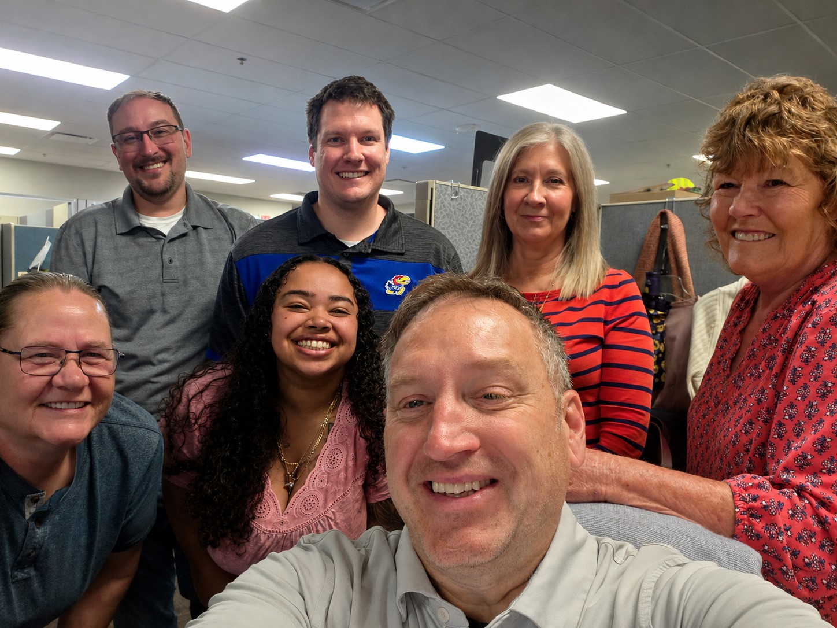
PVD
CAMA TEAM
PRESENTATION

Slide 33
NEW ENHANCEMENT FOR HB2644 COMING SOON
Allow additional review when a property has successfully appealed a valuation within the previous five taxable years and when the current valuation exceeds the prior year’s value by more than 5%.
A qualifying appeal must meet all of the following criteria:
Decision date is after 12/31/2025
Decision date falls within the five-tax-year review period for the working tax year
  Example: A decision date of 04/15/2026 qualifies for tax years 2027 through 2031
Final action equals A-Value Adjusted or STIP-Stipulated
Tyler will provide warning and error functionality that will be available during calculation processing (online and batch) and when using the Final Values Review program
An override checkbox will be created within the calculation criteria to suppress or bypass the warning or error condition.
PVD will configure the calculation statements using the new function and statement types without requiring custom development.

Slide 34
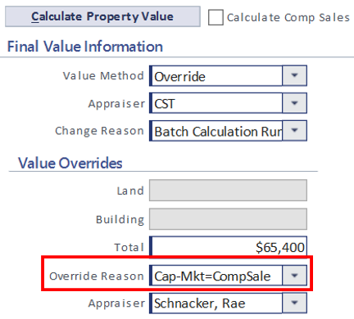
HB2644 – FV Override Reason Codes
PVD will add seven new Final Value Override Reason Codes that will allow counties to comply both with the new law to cap values and the law that requires them to determine fair market value.
When applying a 5% Capped Tax Value, the appraiser will select the Final Value Method that would have been selected for that tax year.
Capcomp Cap-Mkt=CompSale
Capcost Cap-Mkt=Cost
Capinc Cap-Mkt=Income
Capmra Cap-Mkt=MRA
Capovr Cap-Mkt=Override
Capwtd Cap-Mkt=WtEst
Capindex Cap-Mkt=IndexVal

Slide 35
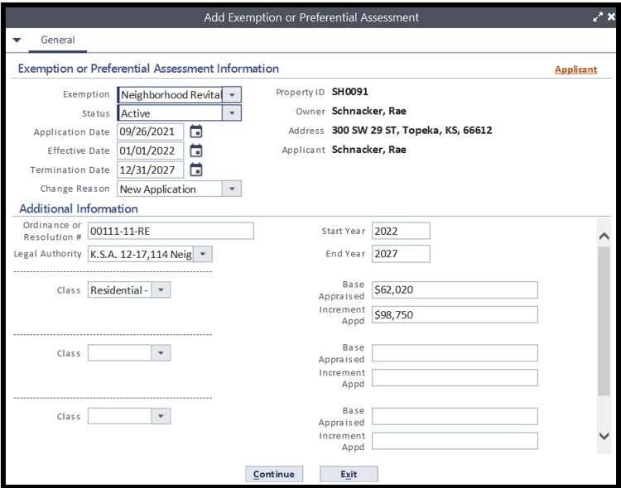
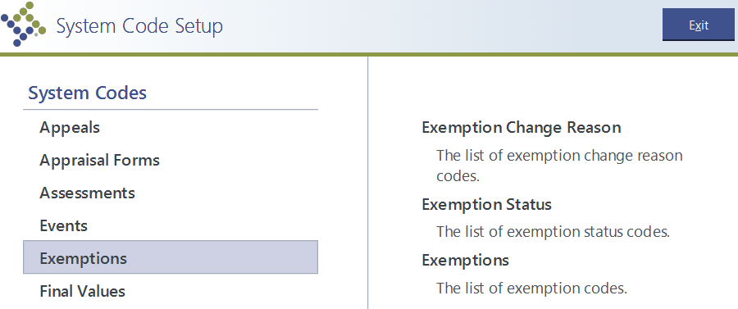
EXEMPTIONS
EVERY EXEMPTION MUST HAVE A RECORD ENTERED INTO ATPRO. THIS INCLUDES NRP, IRB AND EDX EXEMPTIONS.
ONLY BASE CODES SHOULD BE USED.
NEVER CREATE A NEW CODE FOR EXEMPTIONS WITHOUT APPROVAL FROM PVD.

Slide 36
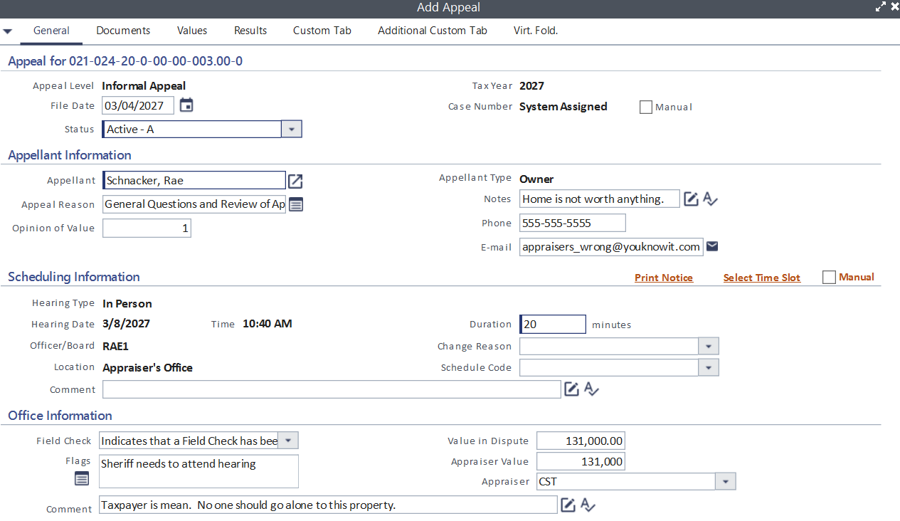
APPEALS
EVERY APPEAL MUST BE ENTERED INTO ATPRO.
INCLUDING INFORMAL, PUP, CLERICAL ERROR, BOTA AND COURT APPEALS
ONLY BASE CODES SHOULD BE USED.
NEVER CREATE A NEW APPEAL LEVEL, ACTION OR STATUS WITHOUT APPROVAL FROM PVD.

Slide 37
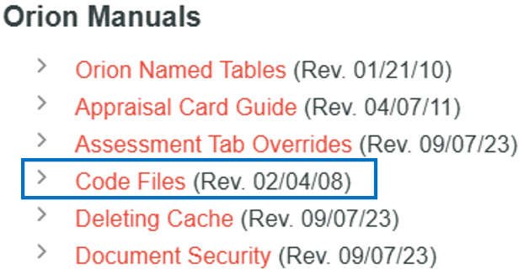
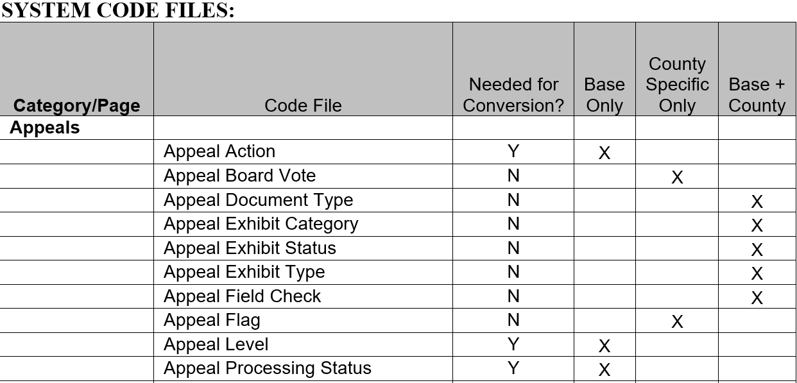
OVERVIEW of CODE FILES AND TABLES
DOCUMENT INCLUDES LIST OF CAMA CODES, SYSTEM CODES AND NAMED TABLE CODES
www.kdor.ks.gov/apps/pvdcama
Base Only - codes that are populated by the system or by PVD and should not be changed by the county.
County Specific Only – codes that will be created by the county.
Base + County – codes that will have a base set of codes, but counties may add to the list.

Slide 38

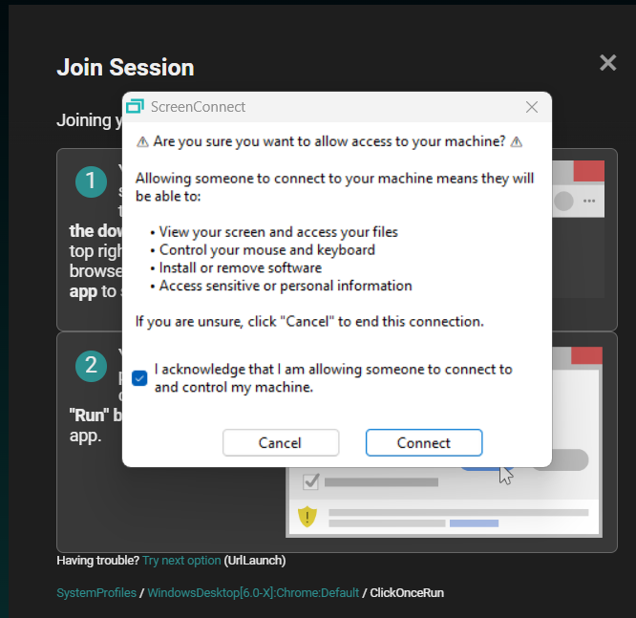
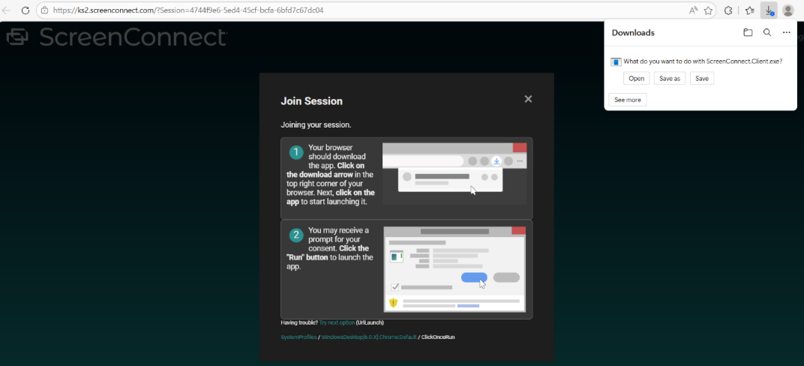
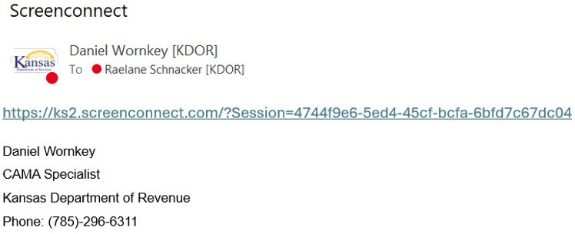
  PVD is now using ConnectWise ScreenConnect for remote access.
  A Link or session code will be sent to the user, who will need to install the ScreenConnect agent or launcher on their machine.
  https://ks2.screenconnect.com

Slide 39
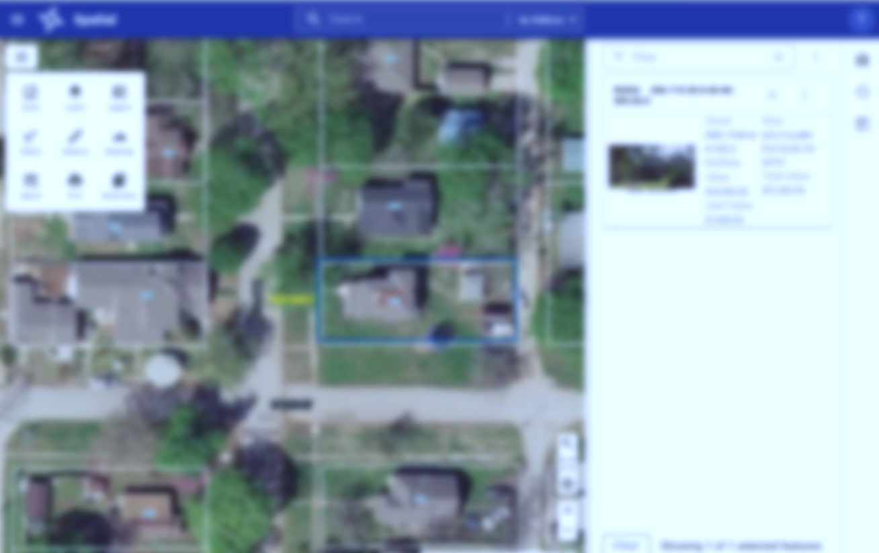
  MVP
  Tyler is currently adding the Res Q1 and Com Q2 MVP values to all county sites for the 2027 tax year.
  PVD CAMA team will be adding the 2027 Custom Component values soon after.
  New MVP Code Changes includes allowing
  Water Tanks / Towers under 162/163 non-buildings:
  Comp Code 6104001 – Wood Tank – Min 200, Max 200,000 gallon
  Comp Code 6104008 – Wood Tower – Min 1,000, Max 40,000 gallon
  Comp Code 6103011 – Welded Steel Water Tank – Min 10,000, Max 10,000,000 gallon
  Comp Code 6103012 – Bolted Steel Water Tank – Min 10,000, Max 1,200,000 gallon
  Comp Code 6103013 – Concrete Water Tank – Min 10,000, Max 10,000,000 gallon
  Comp Code 6104007 – Galvanized Steel Tank – Min 10,000, Max 100,000 gallon
  Comp Code 6105005 – Welded Steel Tank – Min 2,000, Max 500,000 gallon
  Comp Code 6106004 – Vertical Water Tank – Min 1,500, Max 60,000 gallon

Slide 40

Tyler Patch 2026.1.1
PVD is currently testing the patch
Once testing is complete, we will send the deployment schedule to all counties.

Slide 41
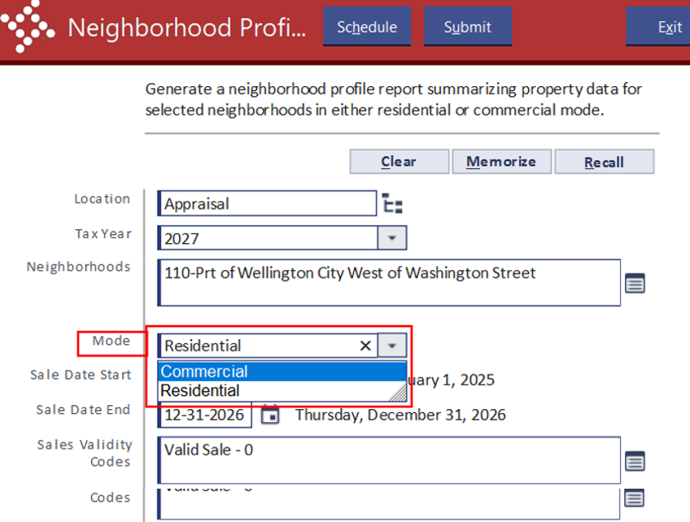
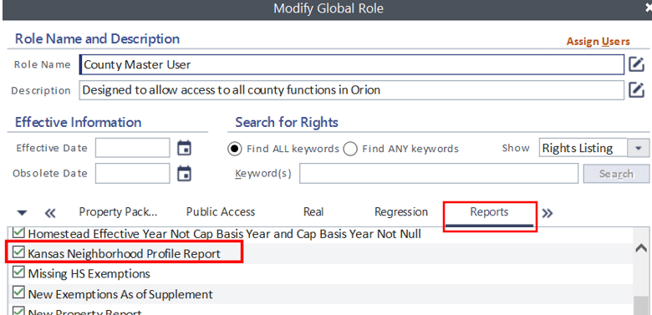
KCAA ENHANCEMENT
NEIGHBORHOOD PROFILE REPORT
Reporting – Kansas Reports –Neighborhood Profile Report
Note: The security right for Kansas Neighborhood Profile Report must be selected under the Reports tab

Slide 42
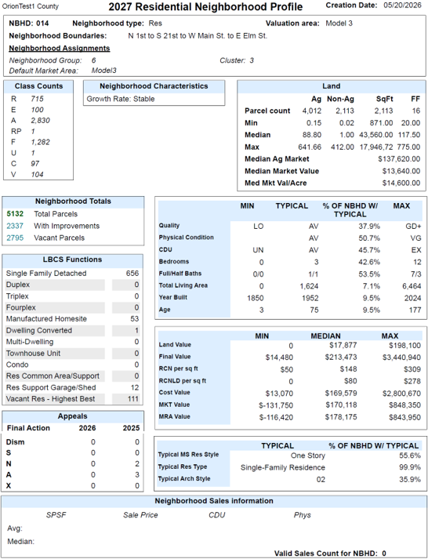
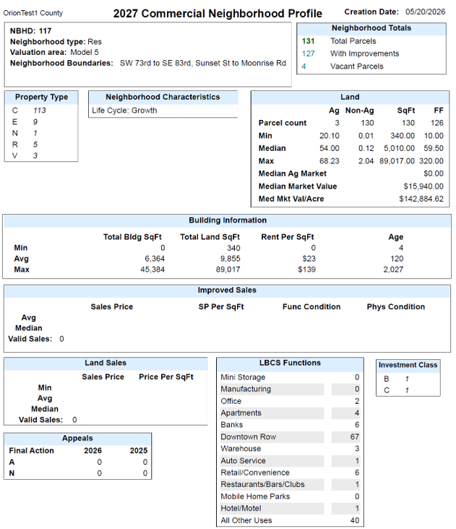

Slide 43
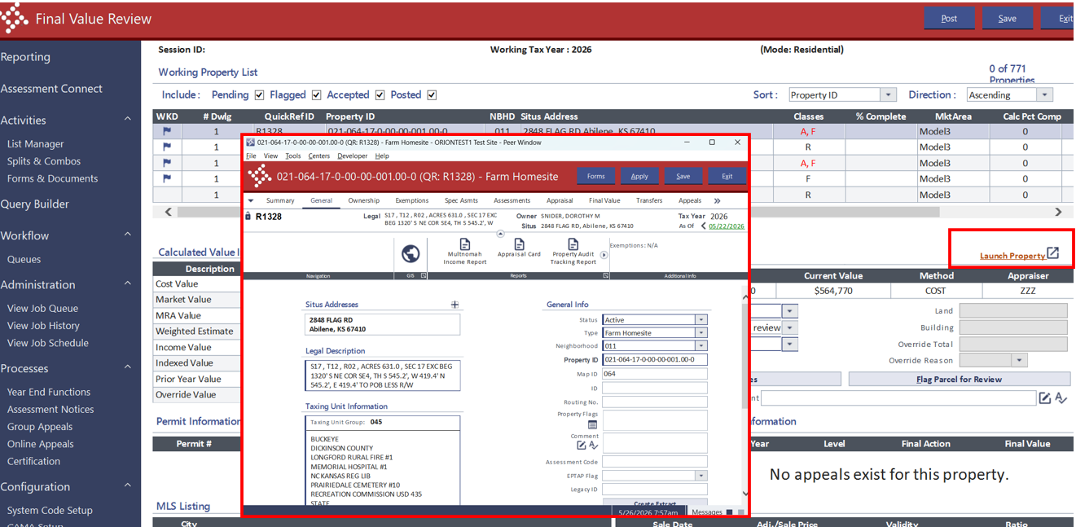
ENHANCEMENT: FINAL VALUE REVIEW PROGRAM
Added ability to launch a property in a peer window
from Final Value Review tab.

Slide 44
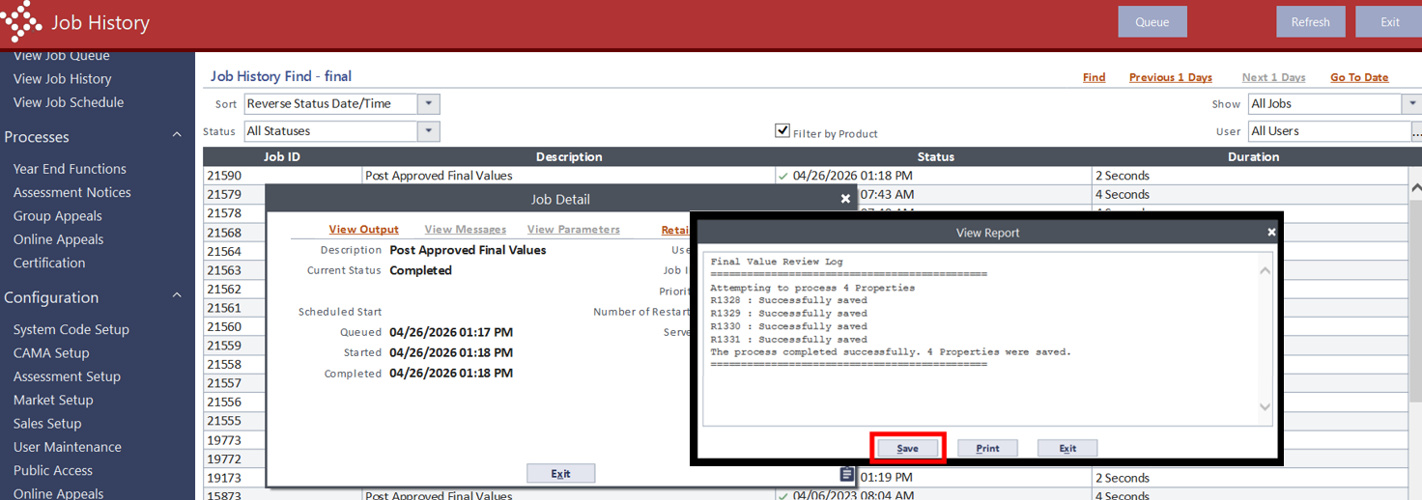
ENHANCEMENT: FINAL VALUE REVIEW
Job Outputs of type 'Text’ can now be Viewed before saving.
Example: When posting the approved Final Values, go to Job History and click View Output – displays
Report with option to Save or Print.

Slide 45
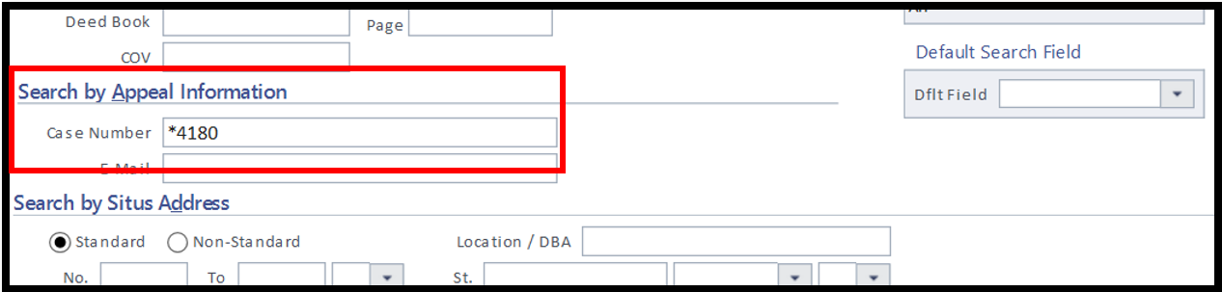
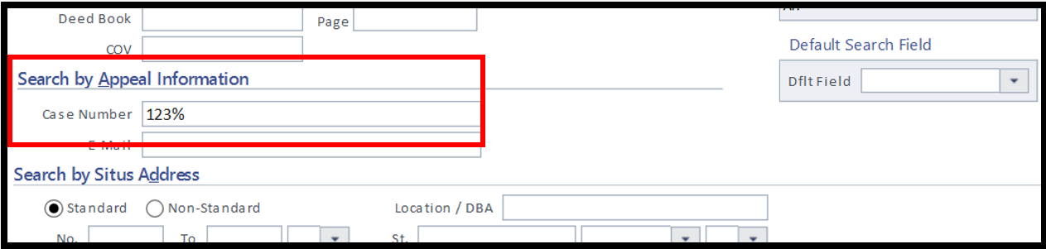
ENHANCEMENT – FIND A PROPERTY PAGE
In the Advanced Property Search, the Appeal Case Number now supports the wild cards * and % search option

Slide 46
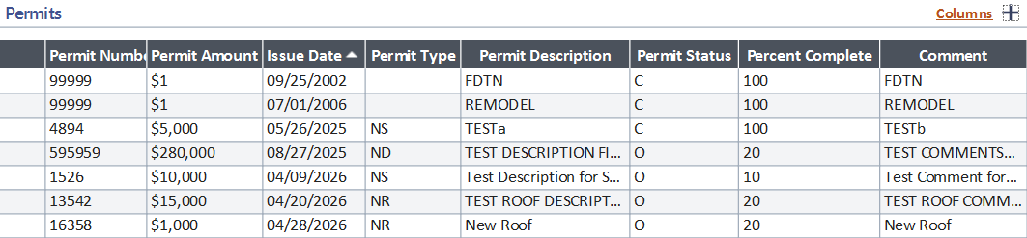
ENHANCEMENT: PERMIT TAB
Updates made to the Permits tab list page
Columns now reflect edits made without having to refresh grid.
Additional Information fields will now sort date type (ie MM/DD/YYYY)
Columns sizes of the grid now respect the memorize settings.
Clicking the save button in the Modify Permit modal no longer relaunches
the dialog box.

Slide 47
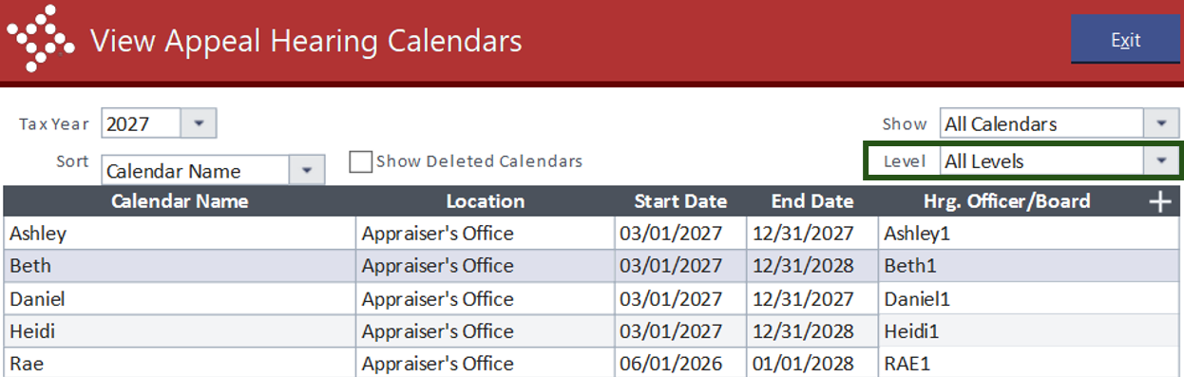
ENHANCEMENT: HEARING CALENDARS
View Appeal Hearing Calendars will default to "All Levels".

Slide 48
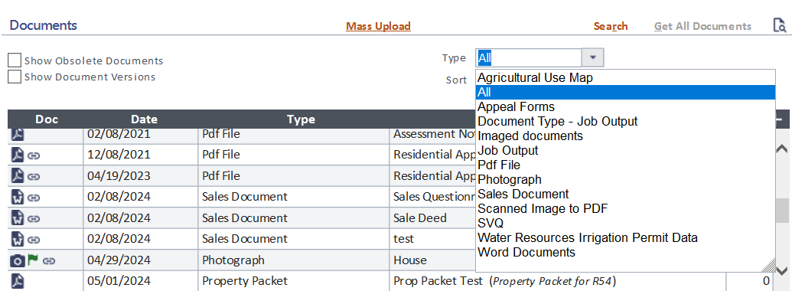
ENHANCEMENT: DOCUMENT TAB
The Document Type dropdown will now sort
in alphabetical order.

Slide 49
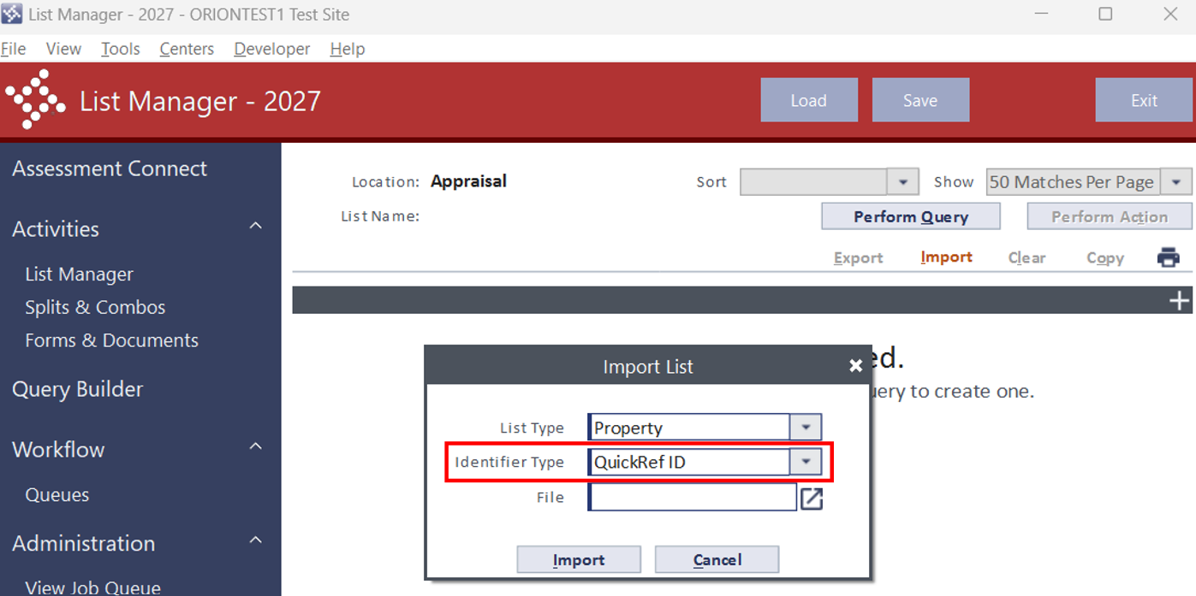
ENHANCEMENT: LIST MANAGER
Property List Identifier for List Manager Imports will
now default to QuickRefID.

Slide 50
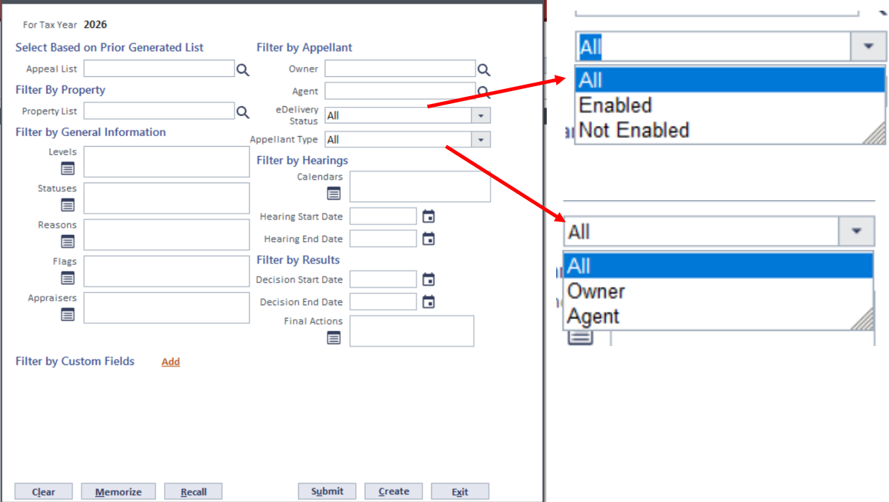
ENHANCEMENT: LIST MANAGER
Add the ability to create Appeal lists to Filter Appellants by eDelivery Status and Appellant Type.

Slide 51
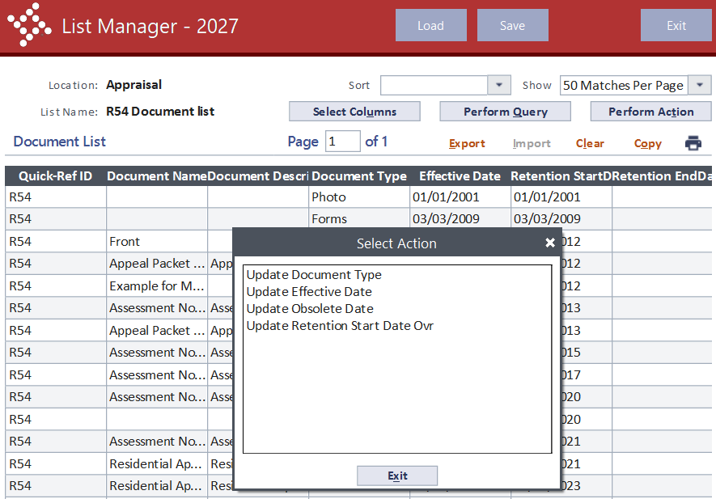
ENHANCEMENT: LIST MANAGER
List Manager Document List now supports four new actions:
Updating Effective Date
Update Obsolete Date
Update Retention Date
Update Document Type

Slide 52
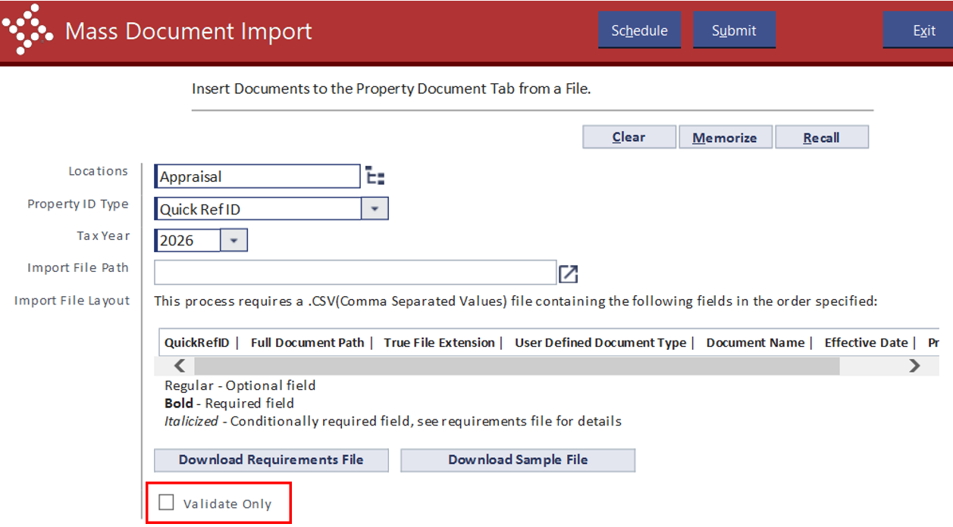
ENHANCEMENT: MASS DOCUMENT IMPORT
Add Validation Only mode

Slide 53
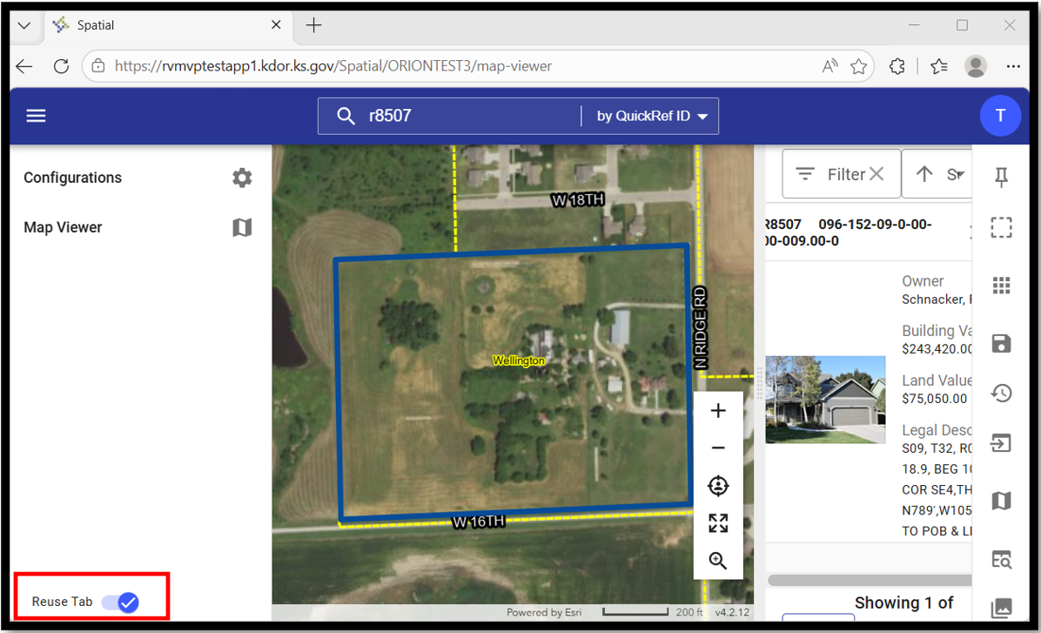

ENHANCEMENT: SPATIAL.
Added a toggle in the navigation menu for ability to reuse a previously launched Spatial tab. This option makes it possible for subsequent properties to open in new tabs, instead of replacing the current Spatial tab in your browser.
.
Clicking the hamburger
(3 horizontal lines) icon in the top left corner will reveal the toggle option to reuse the tab.

Slide 54

2027
PVD SUMMER
ORION UPDATES

Slide 55
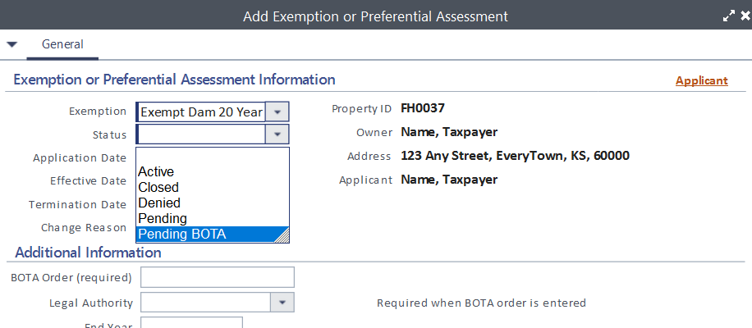
EXEMPTION STATUS CODE
Add a new Status code: PB – Pending BOTA

Slide 56


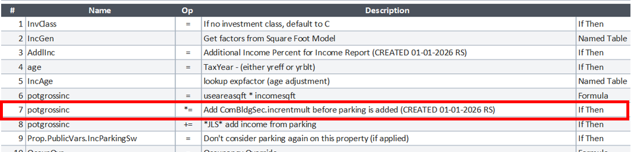
INCOME CALCULATION CHANGE
Modify the Income Calculation statements to adjust for the Income Multiplier Ovr BEFORE parking is added.

Slide 57
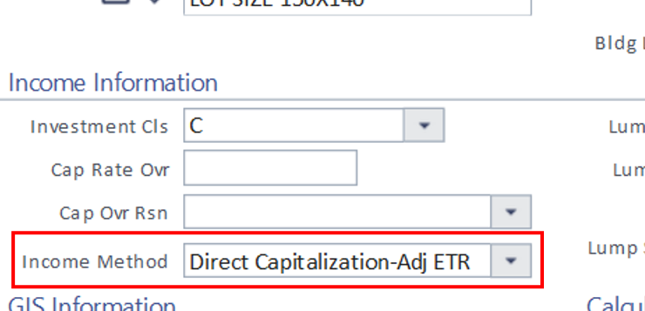
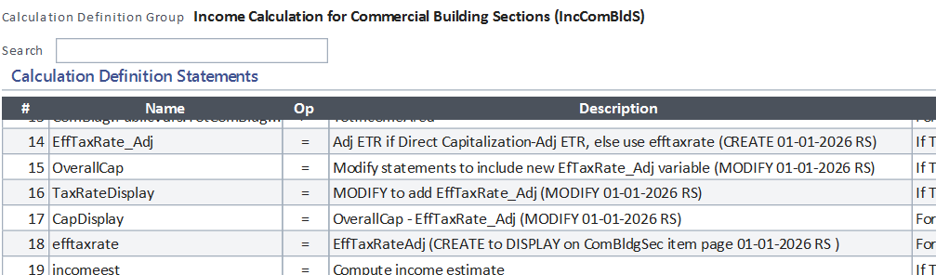
INCOME CALCULATION CHANGE
New Income Method: Direct Capitalization-Adj ETR
Modify calculation statements to include
EffTaxRate_Adj = efftaxrate * (vacancy/potgrsincome)

Slide 58
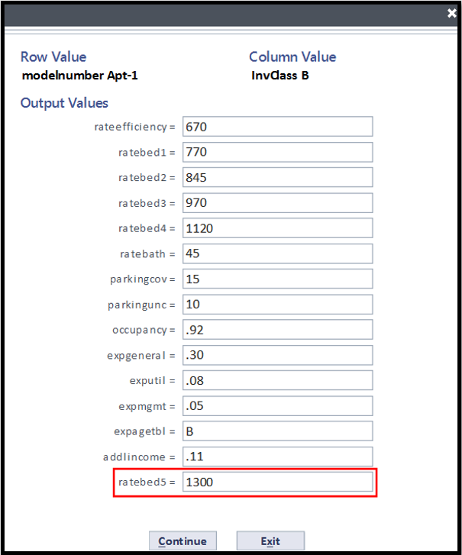
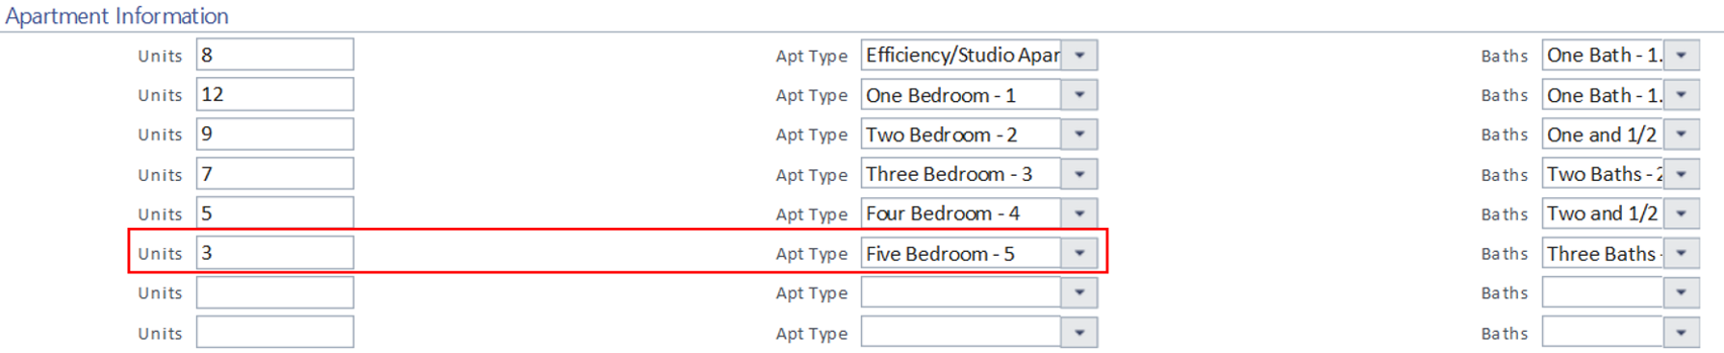
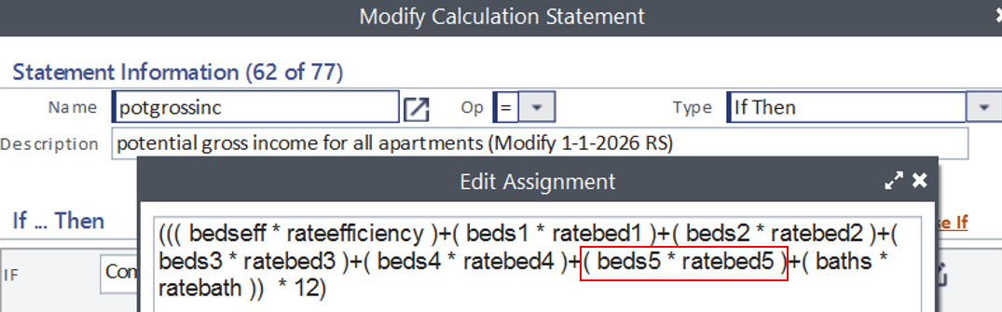
INCOME CALCULATION CHANGE
Add Bed 5 Unit Type for Apartment model

Slide 59
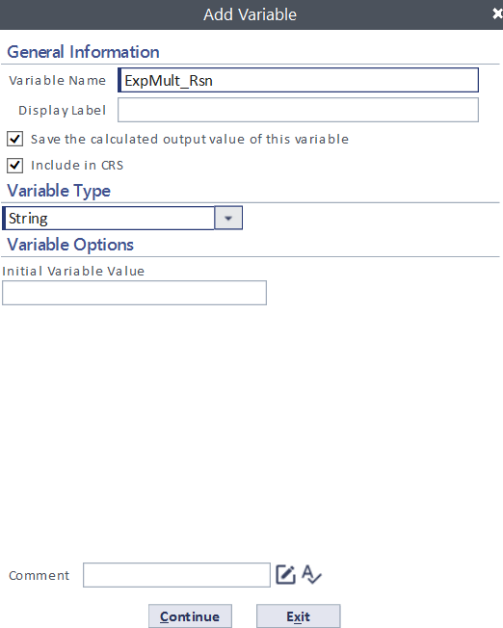
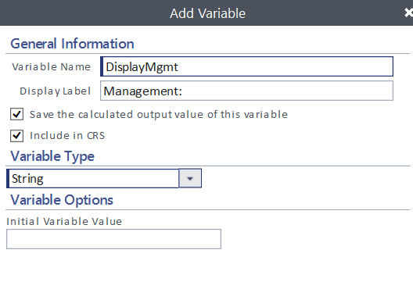
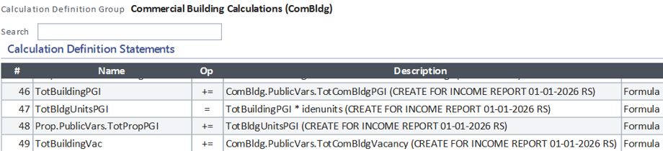
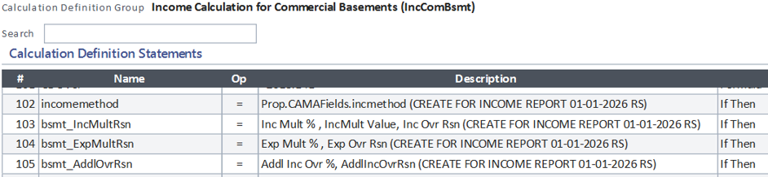
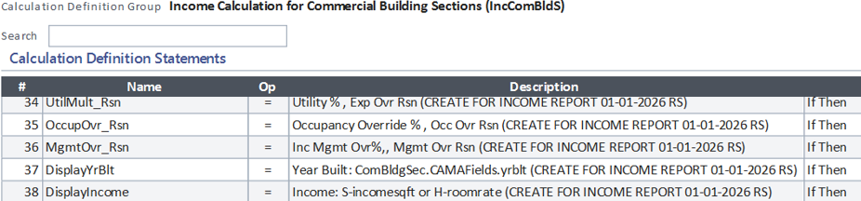
NEW INCOME REPORT ENHANCMENT
PVD WILL ADD VARIABLES AND STATEMENTS CONNECTED TO THIS REPORT TO ALL COUNTY SITES THIS SUMMER

Slide 60
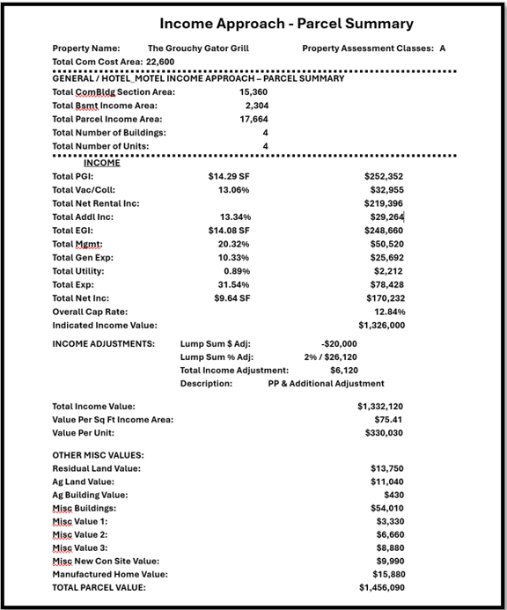

NEW INCOME REPORT ENHANCMENT
COMING THIS FALL

Slide 61

QUESTIONS????

Slide 62
Thank You!

