Slide 1
Online Records for Kansas Appraisers (ORKA)
Kansas Department of Revenue (KDOR)
Kansas Data Access and Support Center (DASC)
2026 KCAA Conference

Slide 2
Introductions
Eileen Battles - DASC Manager
  Geospatial Projects, Initiatives, Data Sharing and Resources
  Local, State, Regional, Federal and National Partnerships
Today’s agenda:
  DASC & KDOR
  Open Records for Kansas Appraisers (ORKA)
  ORKA Portal
  Data - Parcel boundaries, CRS, map services and usage

Slide 3
Data Access & Support Center (DASC)
Established by the GIS Policy Board in 1991
Central repository of GIS databases of statewide & regional importance
Coordination, outreach, & planning
Geospatial technical services for state agencies such as web-based application development & hosting, database development, data validation, and workflow optimization
Administer State Agency Esri EA Agreement
Located at the Kansas Geological Survey

Slide 4

The Big Three
Coordination & Outreach is our enabling technology
1
2
3
GIS Application Development & Workflow Optimization
Coordination & Outreach
Data archive, handling, & publication

Slide 5
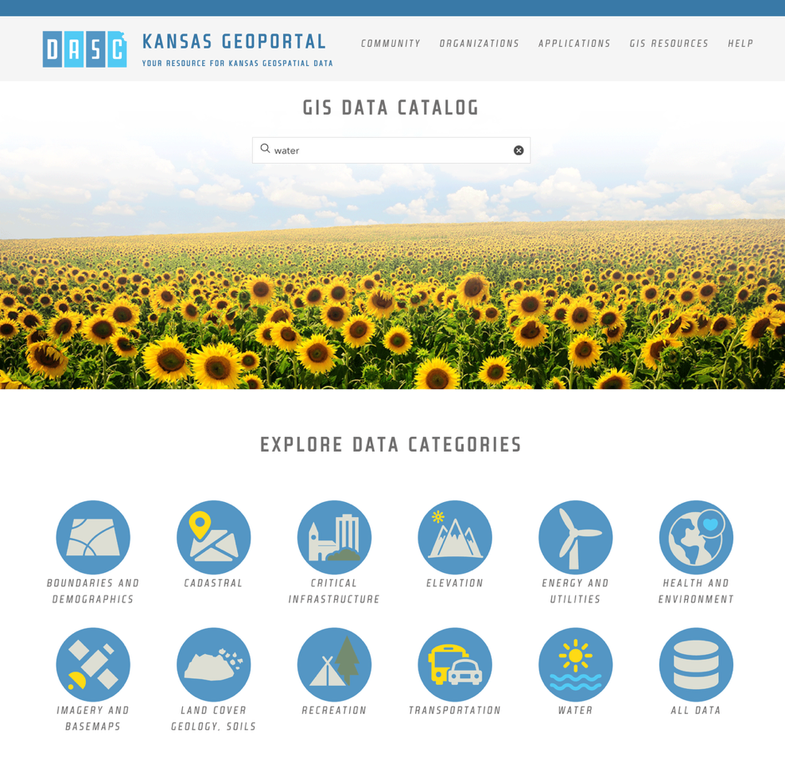
DASC Geoportal Hub
Publicly shared geospatial content from 12 different organizations​
Collaborative technology makes it easier for data stewards to share and update content
FAIR Data Principles
  Findable
  Accessible
  Interoperable
  Reusable

Slide 6
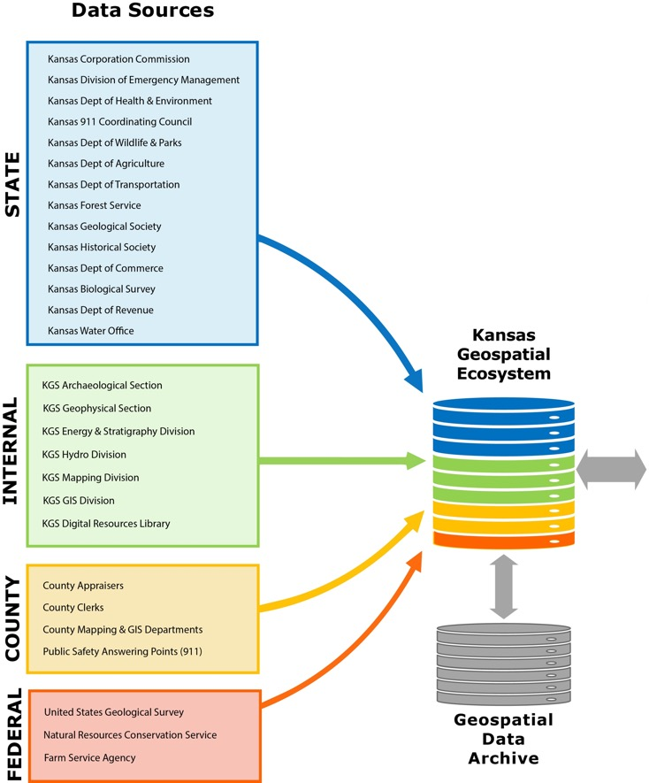
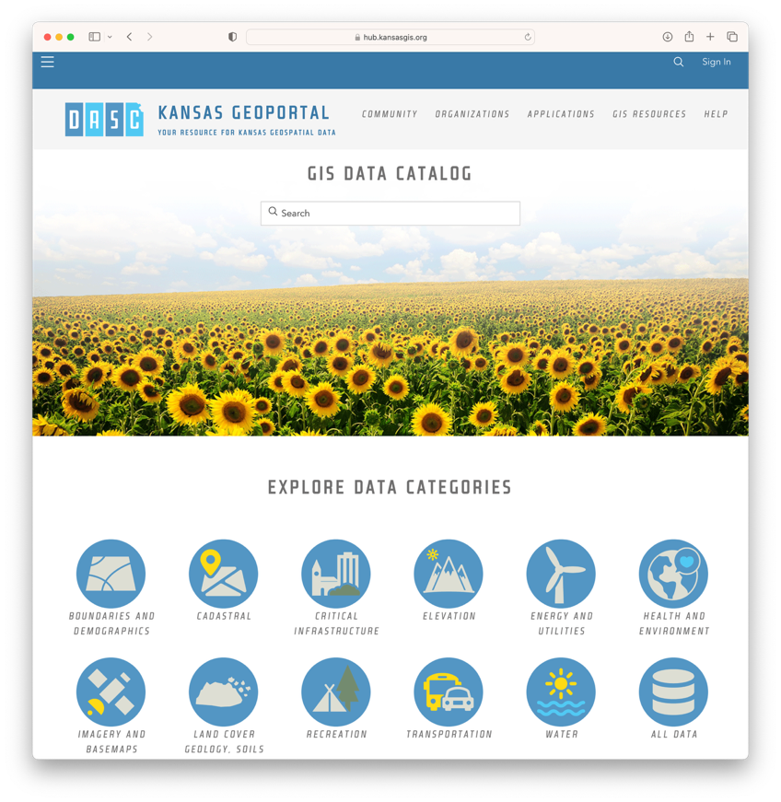
Kansas Geoportal Data Sharing Model

Slide 7
DASC & KDOR – ORKA for Counties
ORKA for counties application developed and maintained by DASC in cooperation with the KDOR
Development of ORKA started in 2011 with a proof of concept pilot application which included Jefferson, Dickinson, & Reno counties, tied to modernization of CAMA system move to ORION
ORKA pairs CRS property data with county GIS parcel boundary data
Available to all Kansas counties

Slide 8
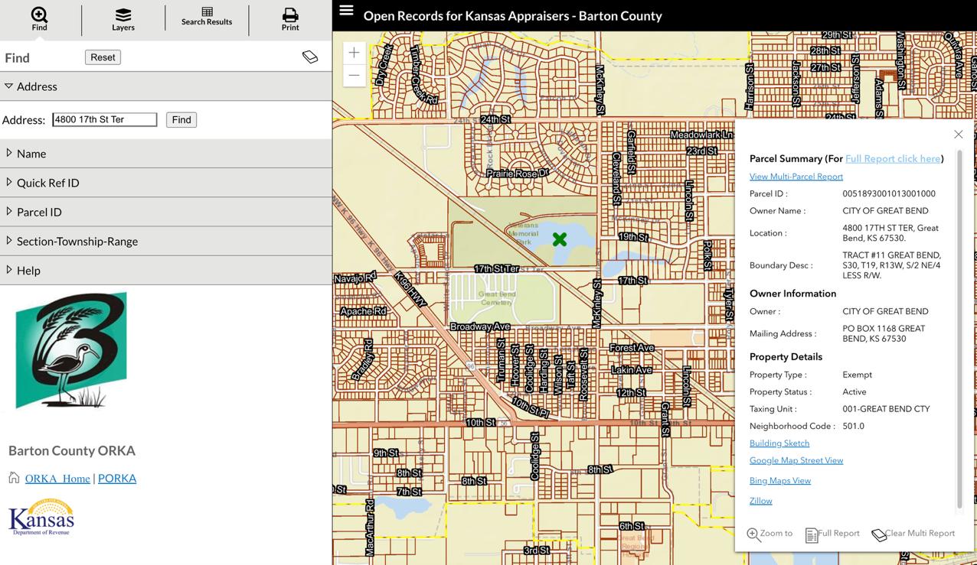
ORKA for Counties
Search by Address, Name, Quick Ref ID, Parcel ID, STR
Ability to toggle layers on/off including multiple years of state and local (if available) imagery
Parcel Summary Report
Ability to view Multi-Parcel Reports
Additional links including Building Sketch, Google Street View, Bing Map View, & Zillow
Notes:
Parcel data is submitted to DASC>aggregated into a statewide data layer>CRS data is joined and this data is what is visible in the ORKA application

Slide 9
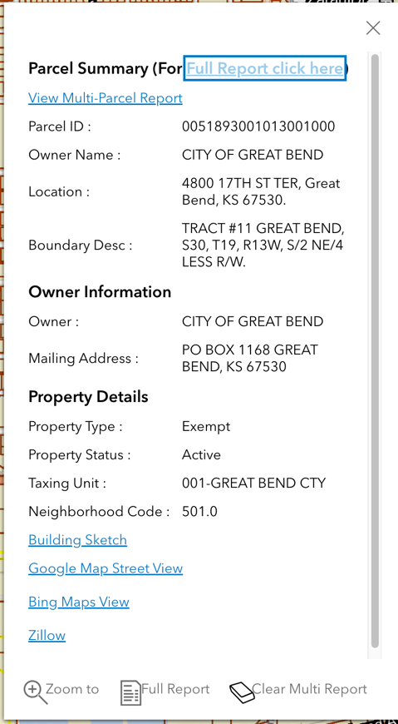
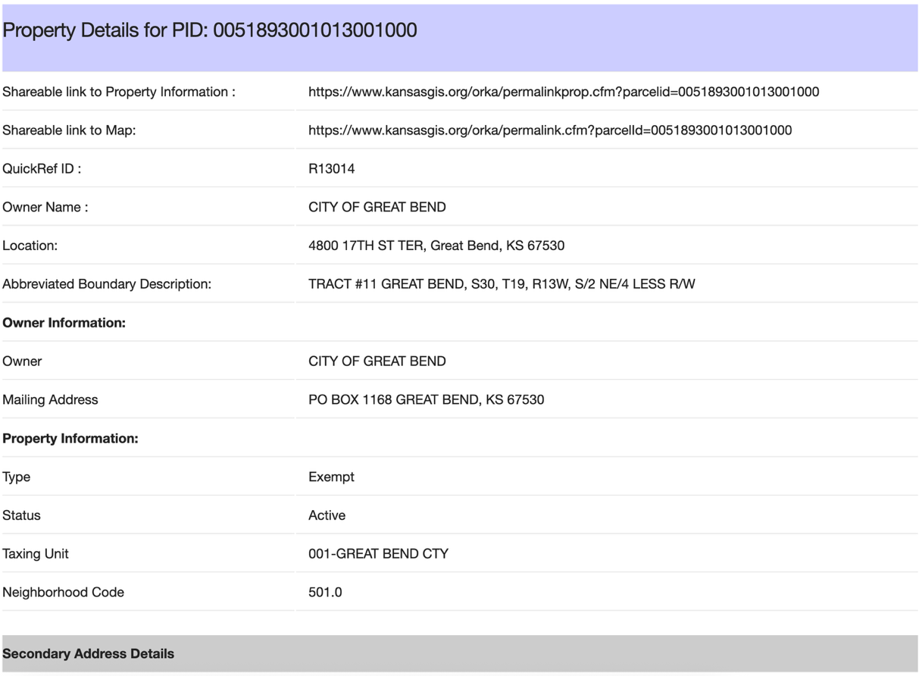
ORKA for Counties – Full Report

Slide 10
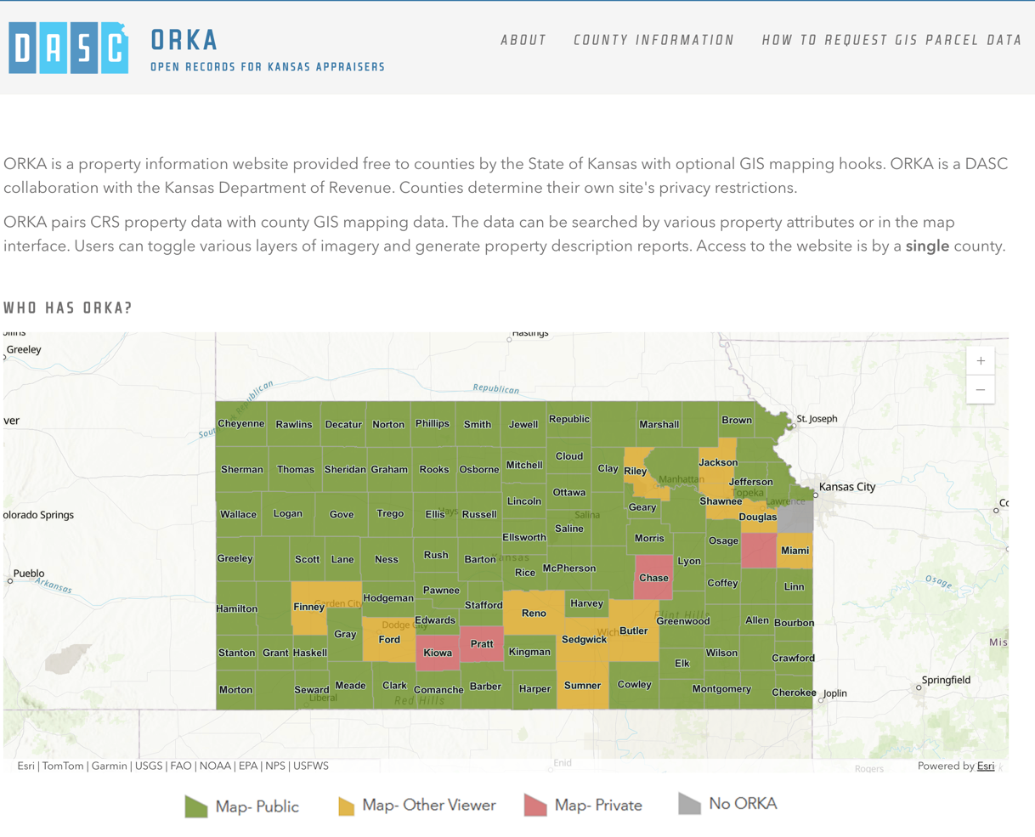
ORKA for Counties – Public/Private/Local
https://orkahub.kansasgis.org/

Slide 11
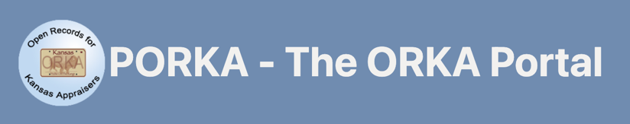
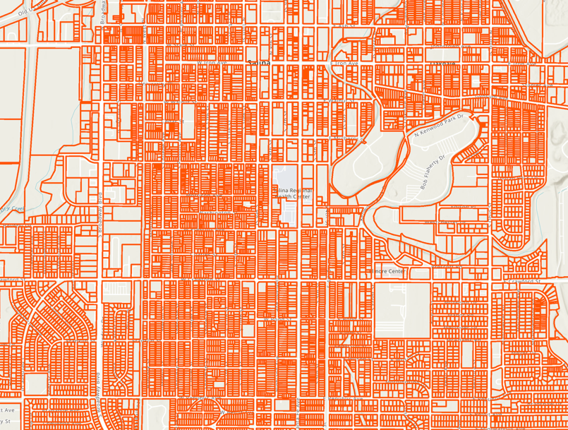


ORKA for Counties – parcel boundaries
There is more than one way to submit parcel boundaries to DASC:
Email
Statewide aggregated parcel GIS data layer

Slide 12

ORKA for Counties – CRS data
Daily CRS download and restore
  DASC downloads 8-10 county CRS files from a CAMA API
  Excludes locally-hosted counties (10)
  Each county every 14 days
  Hosted by DASC in SQL tables and views
  Property and value years in ORKA dictated by county settings in PORKA
Statewide parcel attribute update
  Weekly update of select attributes from each county into a statewide layer
  Used for parcel data requests and Government View-Only REST service for KS agencies
Notes:
ORKA data updated on a 2 week cycle or updated as needed
Locally hosted must be regularly shared for ORKA to be updated and current

Slide 13
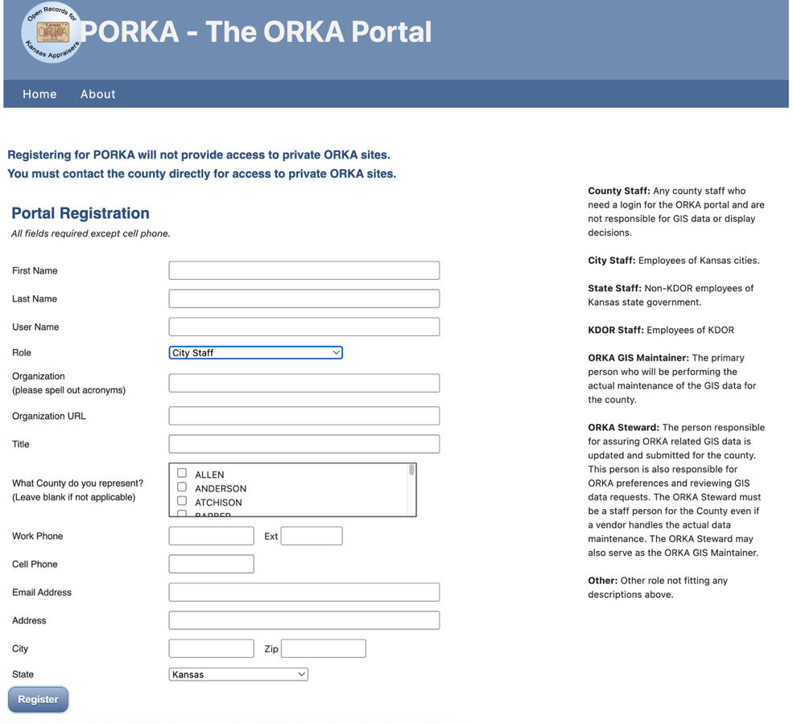
ORKA Portal
Web Based Content and Data Management system developed to support ORKA and services hosted on behalf of KDOR
ORKA Data Steward
  Person responsible for assuring ORKA related GIS data is updated and submitted for the county.
  ORKA preferences and reviewing GIS data requests
  Must be a staff person for the County even if a vendor handle the actual data maintenance
ORKA GIS Data Maintainer
  Person performing the actual GIS data maintenance for the County.

Slide 14
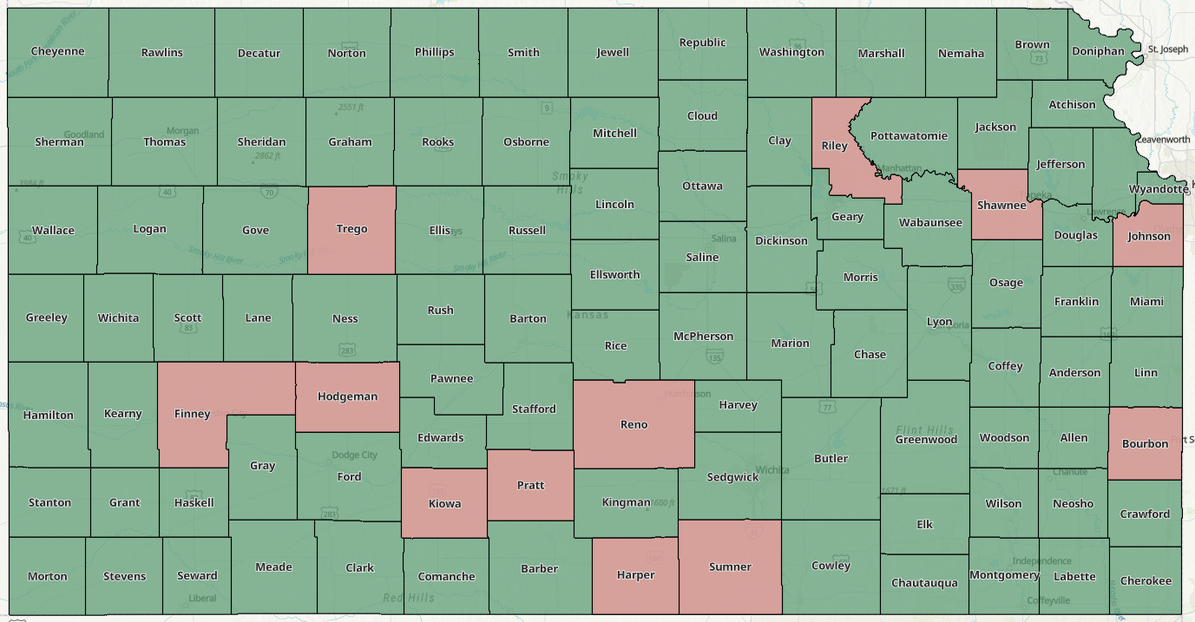
ORKA Portal Steward Status

Slide 15
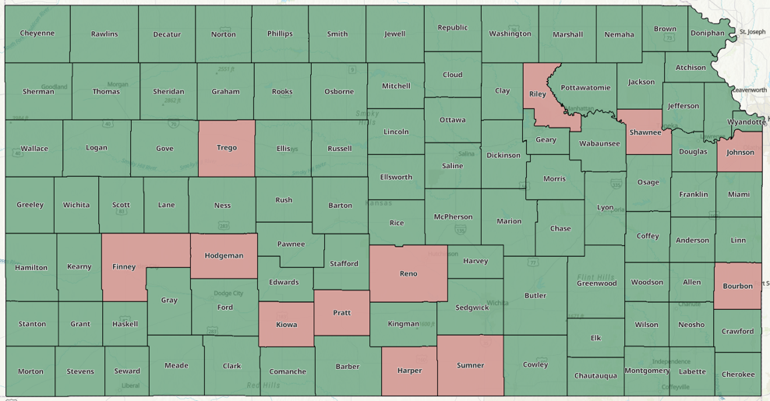
ORKA Portal
Not every county has an active ORKA Data Steward
Steward information could be outdated
  Have you logged into PORKA lately?
  Who is the Steward for your county?
  Do you upload parcel boundary data to PORKA? If not, who is responsible for uploading data on your behalf?
  Have you had any staff changes or retirements lately?
Why do you need a ORKA Data Steward?
  Communication
  ORKA Settings
  Data Requests
  Data Uploads
Notes:
Please log in and review of existing ORKA accounts

Slide 16
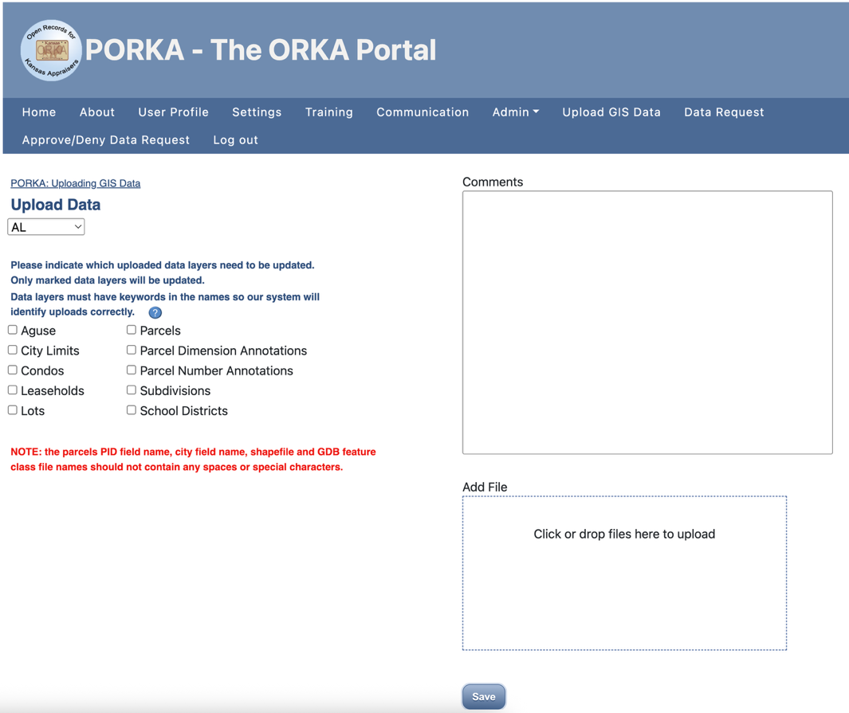
ORKA Portal – uploading data
Data Submissions
  Parcels
  City Limits
  School Districts
  Various property related data
Important - Upload data frequently!
Parcel data requests
  Approx 200 request received annually
  Auto Approve/Deny
Communicate important updates and announcements with ORKA Data Stewards and County Appraisal Staff
Notes:
Request examples – tracking contamination clean up, NG911 comparison and validation, installing fiber optic cable, disaster planning exercises, city permitting and planning, roadway design, update school board zones

Slide 17
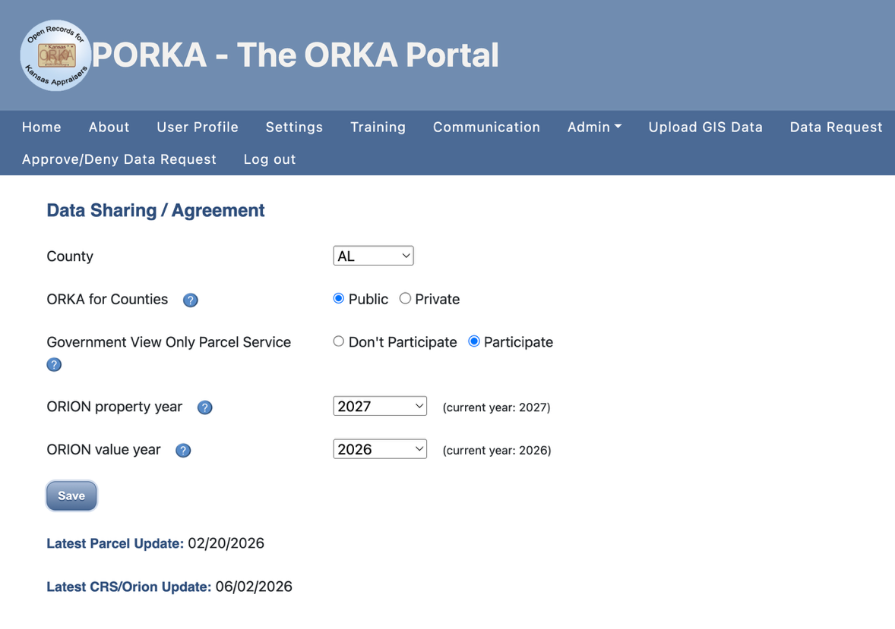
ORKA Portal - Settings
Settings>
  ORKA for Counties
  ORKA Property Year – controls which year of ownership and property information is displayed in ORKA
    General guideline – if after June, the property year should be set to the next calendar year
  ORKA Value Year – controls which year of property values are displayed in ORKA
    General guideline – if after March, the value year should be set to the current calendar year
Notes:
General guidelines but each county has a different certification schedule, property year or value year change joins to appropriate year to pull attribute information,
change is not instant – delay between certification and pushing those changes to county via ORION and DASC getting CRS data

Slide 18
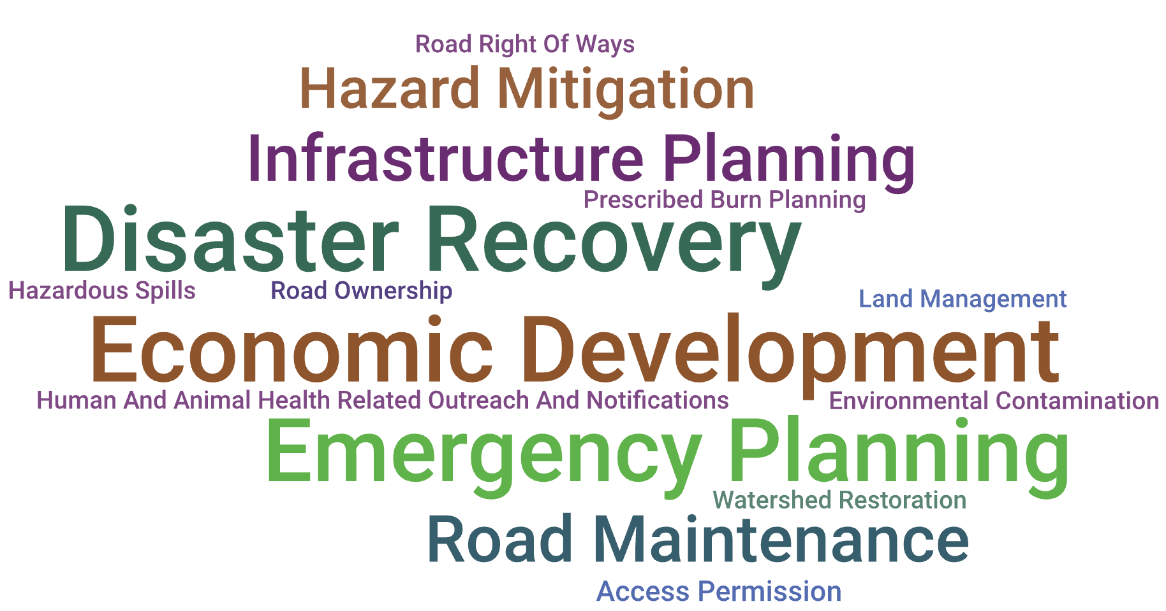
How is Parcel data used?
ORKA is a VERY popular application, millions of hits annually
Map services integrated into ORKA, Tyler Spatial, Assessment Connect, NG911
Parcel Data Requests
Government View Only Parcel Service
Notes:
Parcels aren’t used just for appraisal purposes, many other needs
Assessment Connect – parcels, tax units, soils, military boundaries, county boundaries, school districts, city boundaries, state boundary
Spatial – parcels, imagery, additional parcel related data, NG911 address points, NG911 roads, soils, city boundaries, county boundaries
Recent data request examples

Slide 19
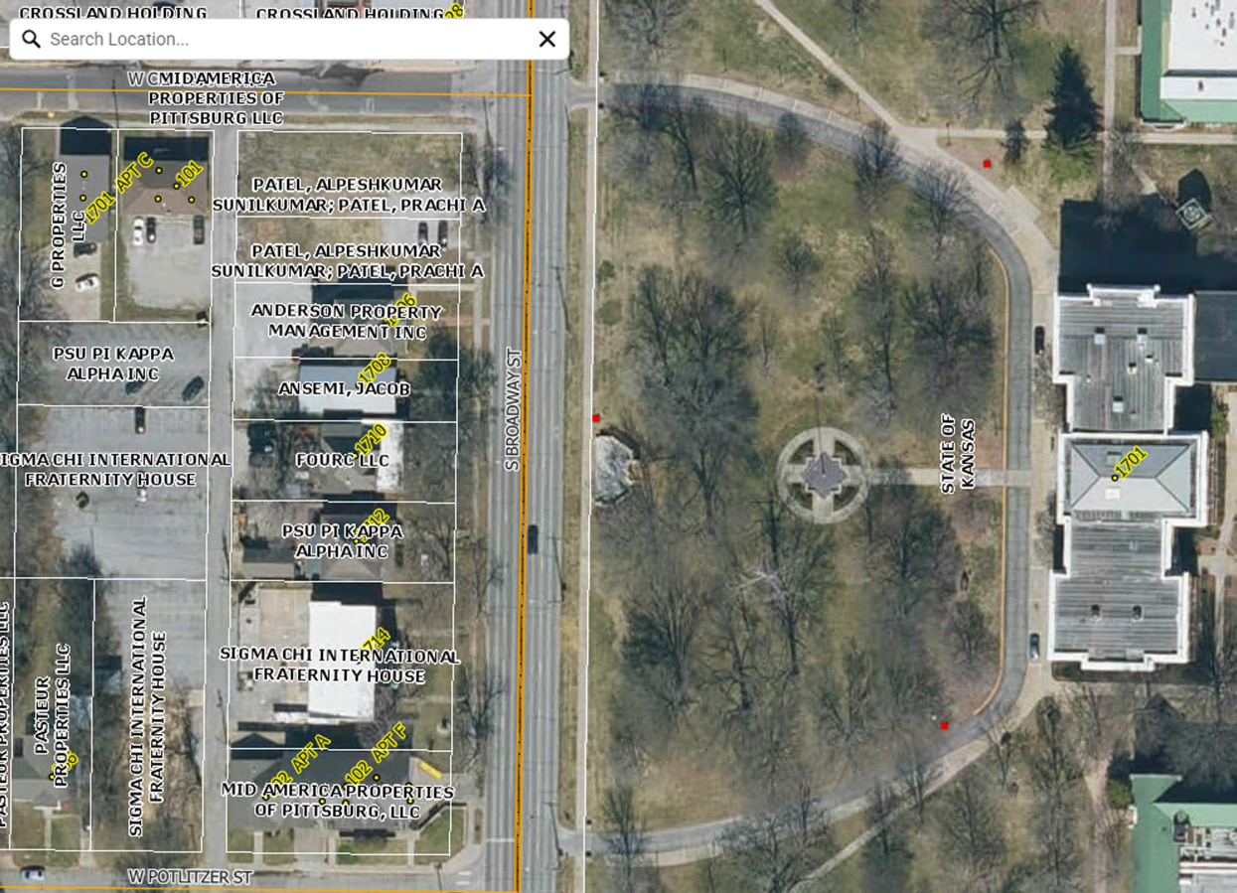
How is Parcel data used?
Kansas NG911
City of Pittsburg
Crawford County

Slide 20
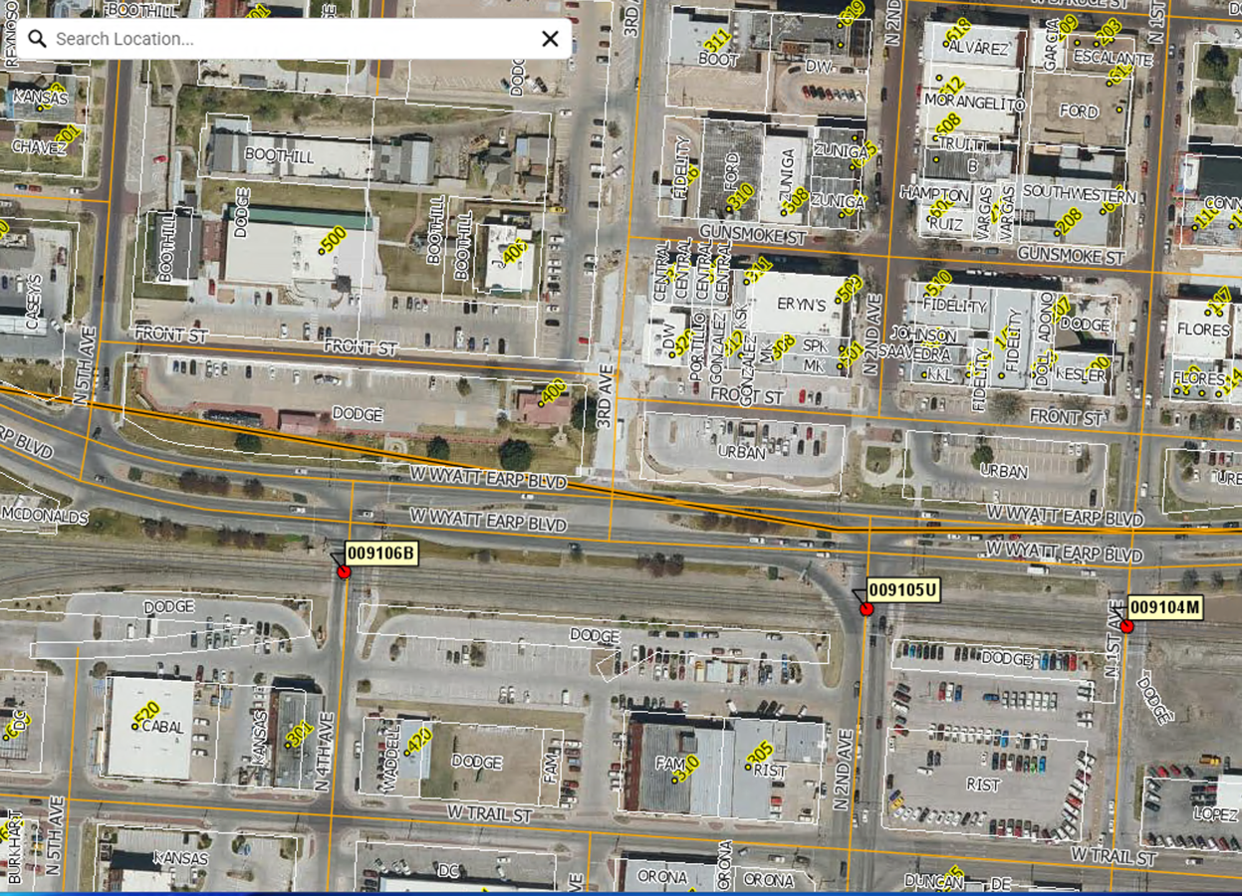
How is Parcel data used?
Kansas NG911
Dodge City
Ford County

Slide 21
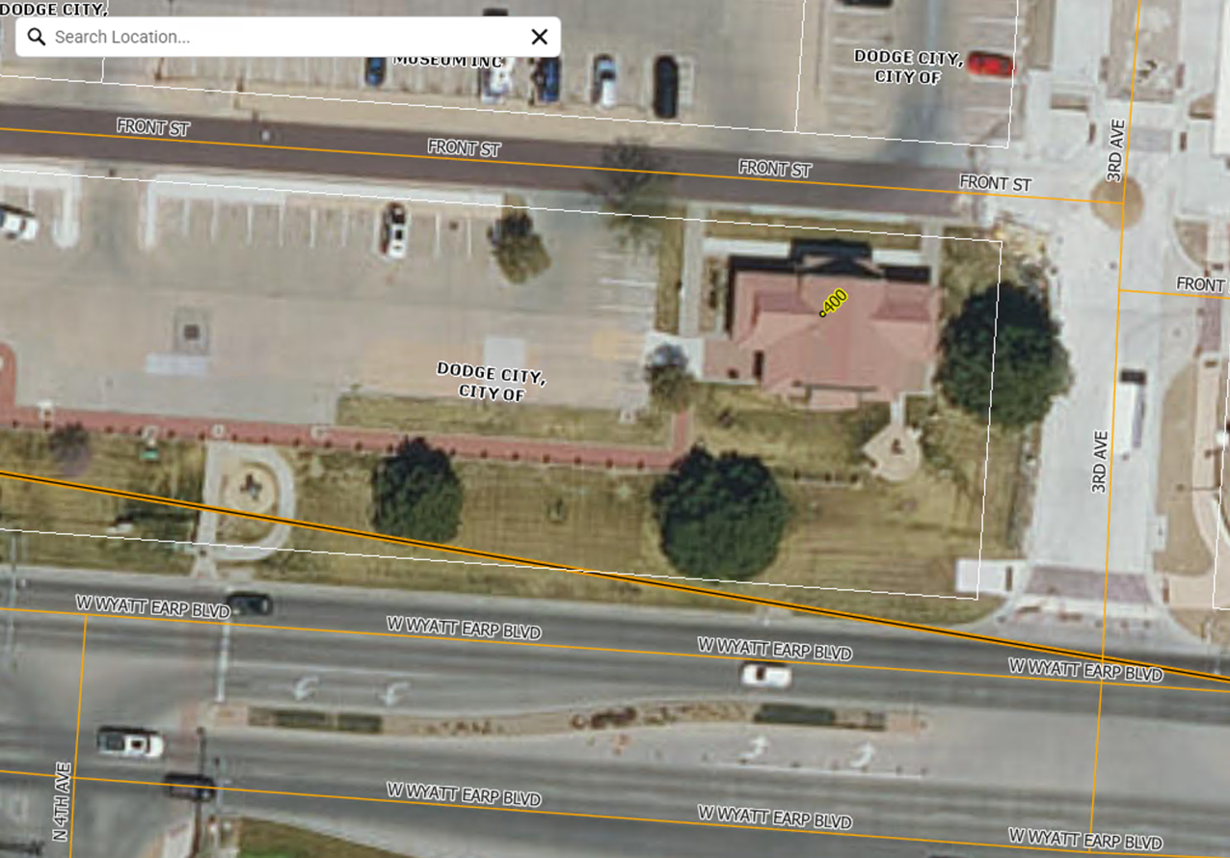
How is Parcel data used?
Kansas NG911
Dodge City
Ford County

Slide 22
Publicly shared data
Why is DASC involved? It is all about the data
NG911 Imagery – 2015, 2018, 2021, 2024, 2027
NAIP Imagery – multiple years
LIDAR (elevation) data – multiple years
Geocoding services, school districts, soils, tax units, … many more
Coordination & Outreach is our enabling technology
1
2
3
GIS Application Development & Workflow Optimization
Coordination & Outreach
Data archive, handling, & publication

Slide 23
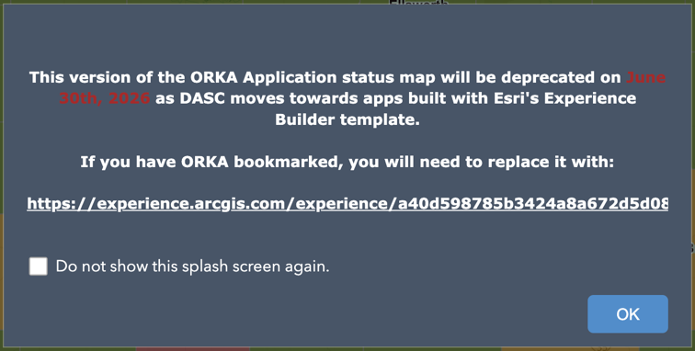
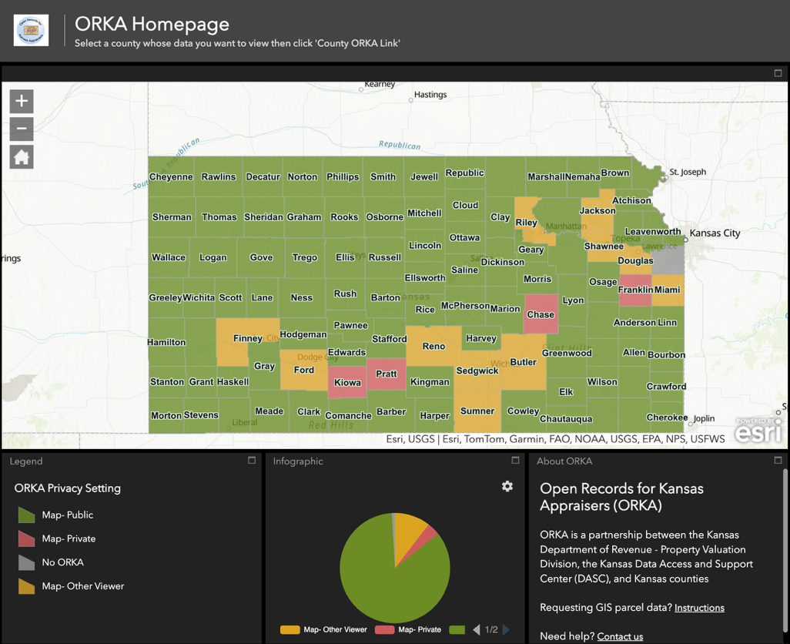
ORKA Future
ORKA Homepage– new URL

Slide 24
ORKA Future
Application – rebuild ORKA
Migrate to cloud
  Reengineer and update the technology behind the application
  Improve uptime & performance
Map and imagery service optimization
Additional enhancements based on user feedback

Slide 25
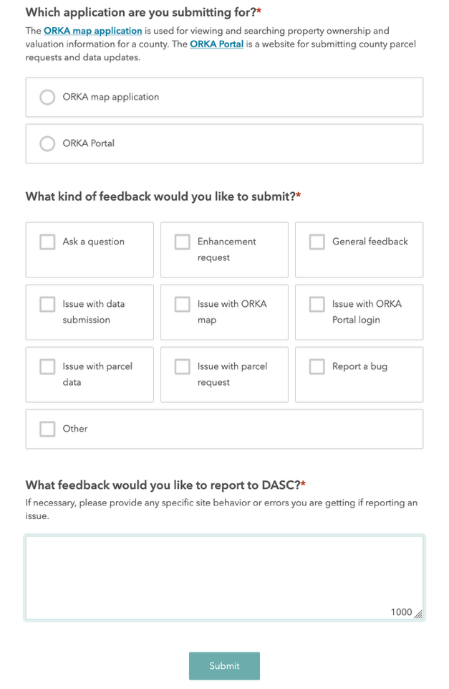
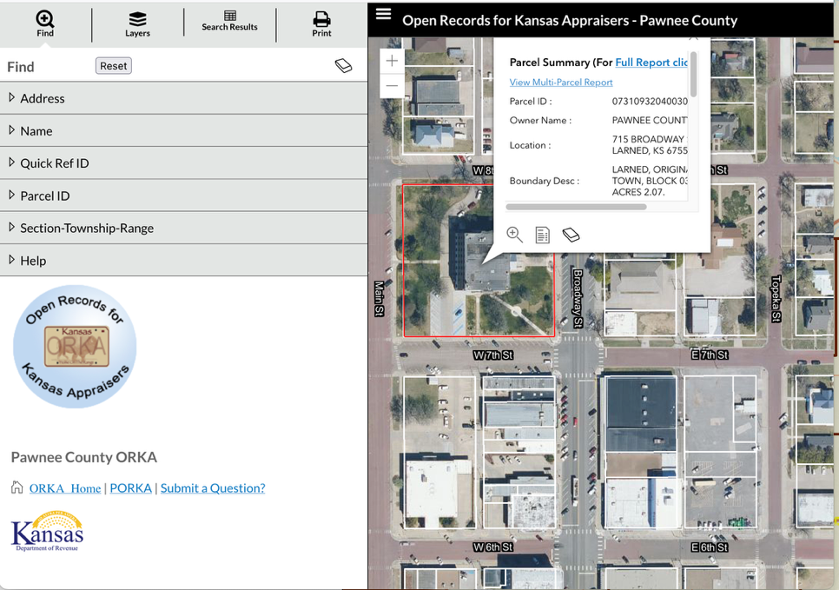
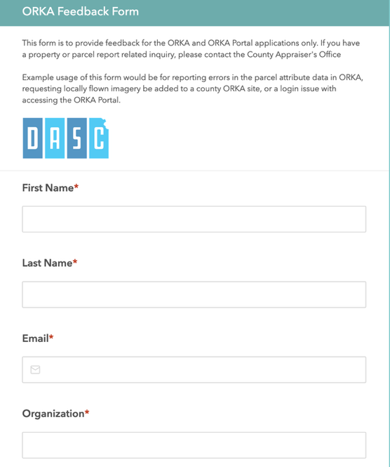
ORKA Feedback Form

Slide 26

ORKA Contact
Dave Grolling
GIS Developer
dgrolling@ku.edu
DASC Hub, State of Kansas AGO ORG, ORKA/PORKA, DASC data

